Slide 1
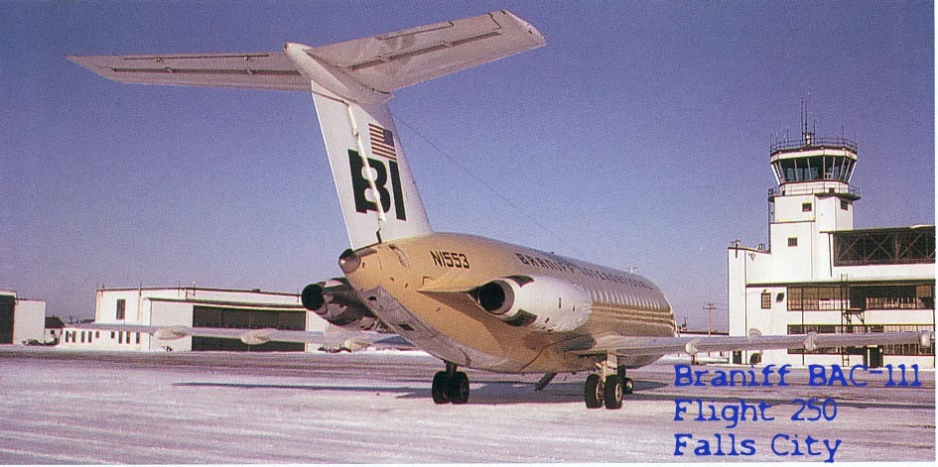
BRANIFF INTERNATIONAL AIRWAYS FLIGHT 250
11:10 P.M. SATURDAY, AUGUST 6, 1966
FALLS CITY, NE

Slide 2
Primary Sources
The Falls City Journal, Bill Schock
University of Texas-Dallas at Richardson, Eugene McDermott Library, Special Collections Department, The History of Aviation Collection, The General Aviation Collection.
Texas Tech University, The Southwest Collection Archive within the Special Collections Library, Dr. Tetsuya Theodore “Ted” Fujita papers.
Family of James Hilliker

Slide 3
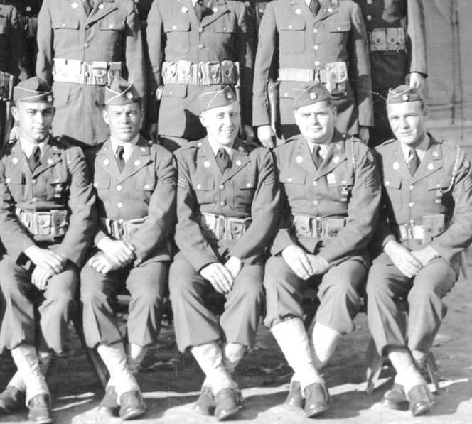
BILL SCHOCK
THE FALLS CITY JOURNAL

Slide 4
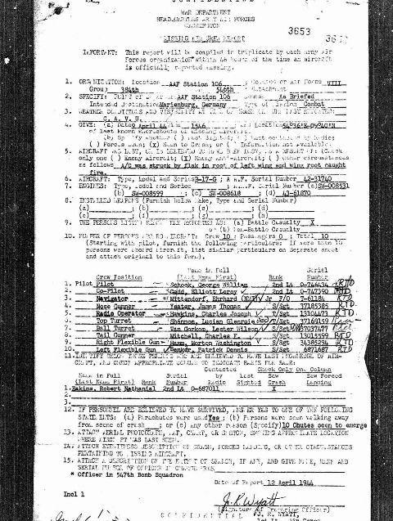
MISSING AIRCRAFT REPORT, 12 APRIL 1944
HEADQUARTERS, EIGHTH AIR FORCE, ENGLAND

Slide 5
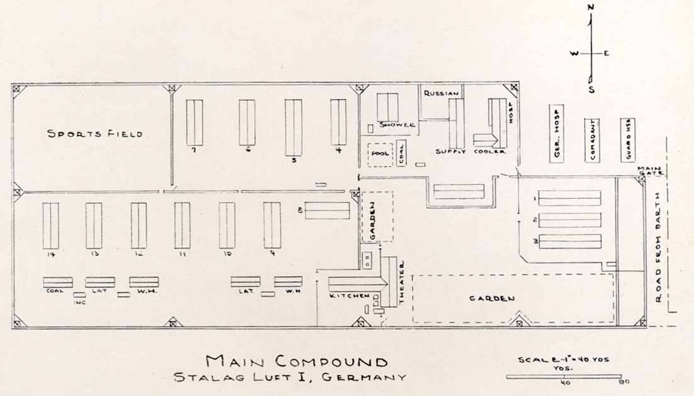
STALAG LUFT I, GERMANY
1944-45

Slide 6
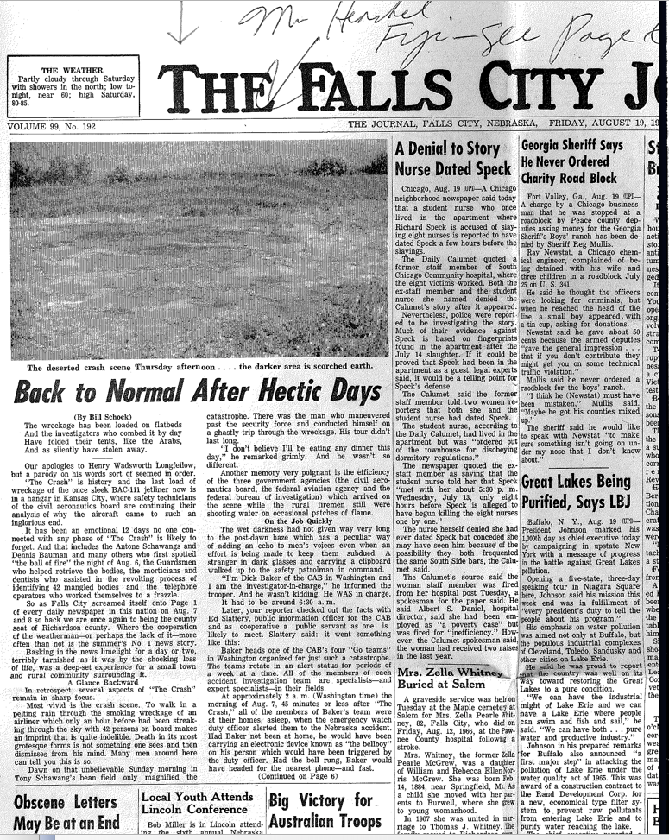
AUTOBIOGRAPHY/FC JOURNAL
BILL SCHOCK

Slide 7
BRITISH AIRCRAFT CORPORATION
AIRLINE
ONE-ELEVEN (1-11)
1ST FLIGHT
20-AUG-1963
ORDERS
244

Slide 8
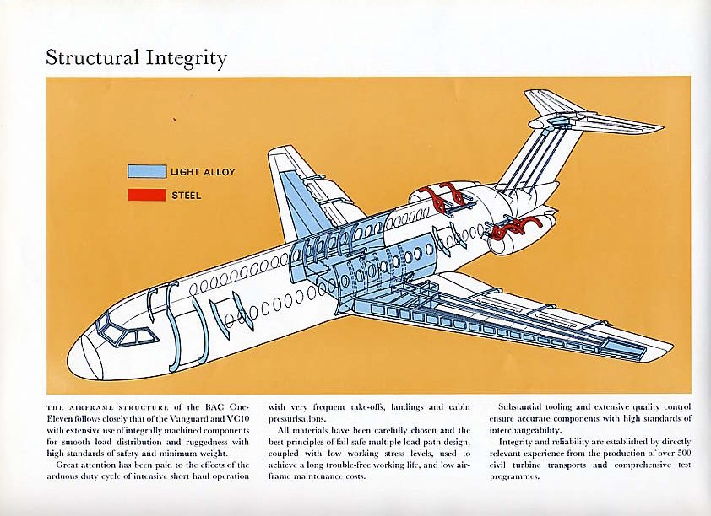
BAC 1-11
PROJECT
STRUCTURAL INTEGRITY
DATE
BUILT BEYOND BRITISH AND AMERICAN STANDARDS

Slide 9
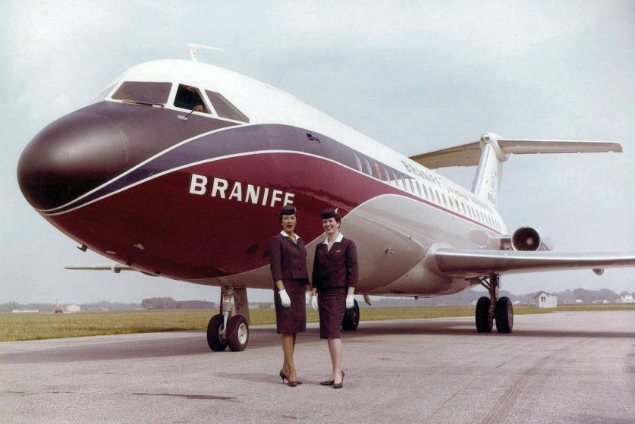
BAC 1-11 N1547 AT HURN, ENGLAND, WITH BN STEWARDESSES
JUST BEFORE THE GREAT SHAKEUP

Slide 10
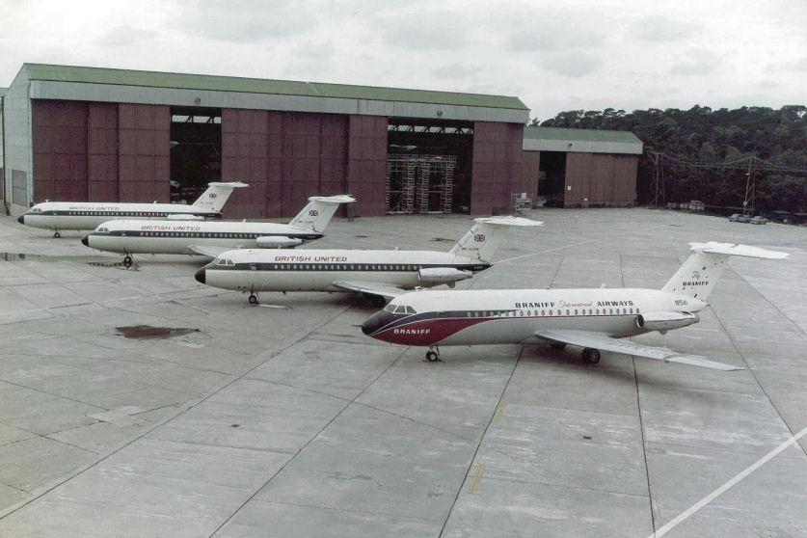
BRAND NEW
FIRST BAC 1-11 FOR BRANIFF ON THE FLIGHT LINE AT HURN

Slide 11
BAC 1-11 ENGINE START
HOLD YOUR EARS

Slide 12
A DUSTY LITTLE AIRLINE BRANIFF AIRWAYS

Slide 13
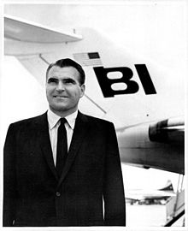
1964: GREAT AMERICA BUYS BRANIFF
HARDING LAWRENCE, AN EXECUTIVE VICE PRESIDENT AT CONTINENTAL IS HIRED AS CEO/PRESIDENT OF BN.

Slide 14
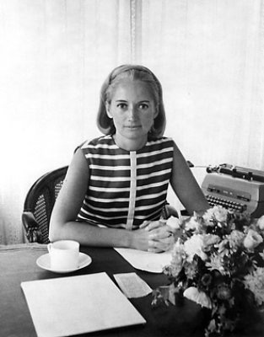
LAWRENCE HIRES MARY WELLS
TO SHAKE THE DUST OFF THE DUSTY TEXAS AIRLINE

Slide 15
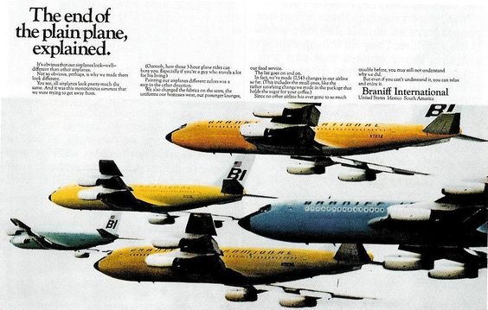
EASTER EGGS
FLYING COLORS

Slide 16
CHA CHA CHA!
THE END OF THE PLAIN PLANE

Slide 17
THE AIR STRIP
VISUALIZED

Slide 18
THE AIR STRIP
EMILIO PUCCI GETS CREATIVE

Slide 19
AIR STRIP REALITY
WHAT THEY ACTUALLY WORE

Slide 20
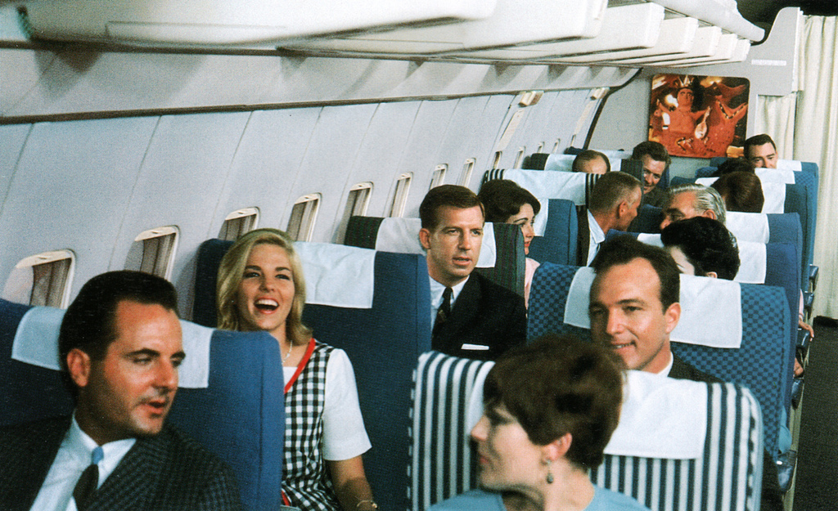
ALEXANDER GIRARD | SANTA FE, NM
INTERIORS/EXTERIORS OF AIRCRAFT, AIRPORTS AND FABRICS AND PRINTS

Slide 21
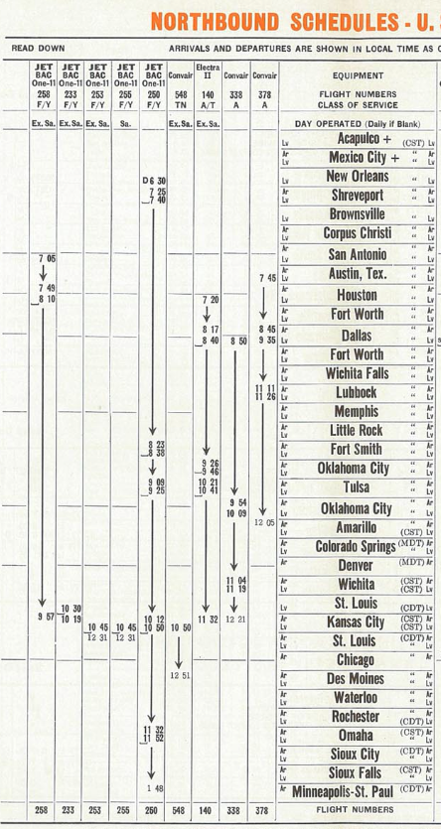
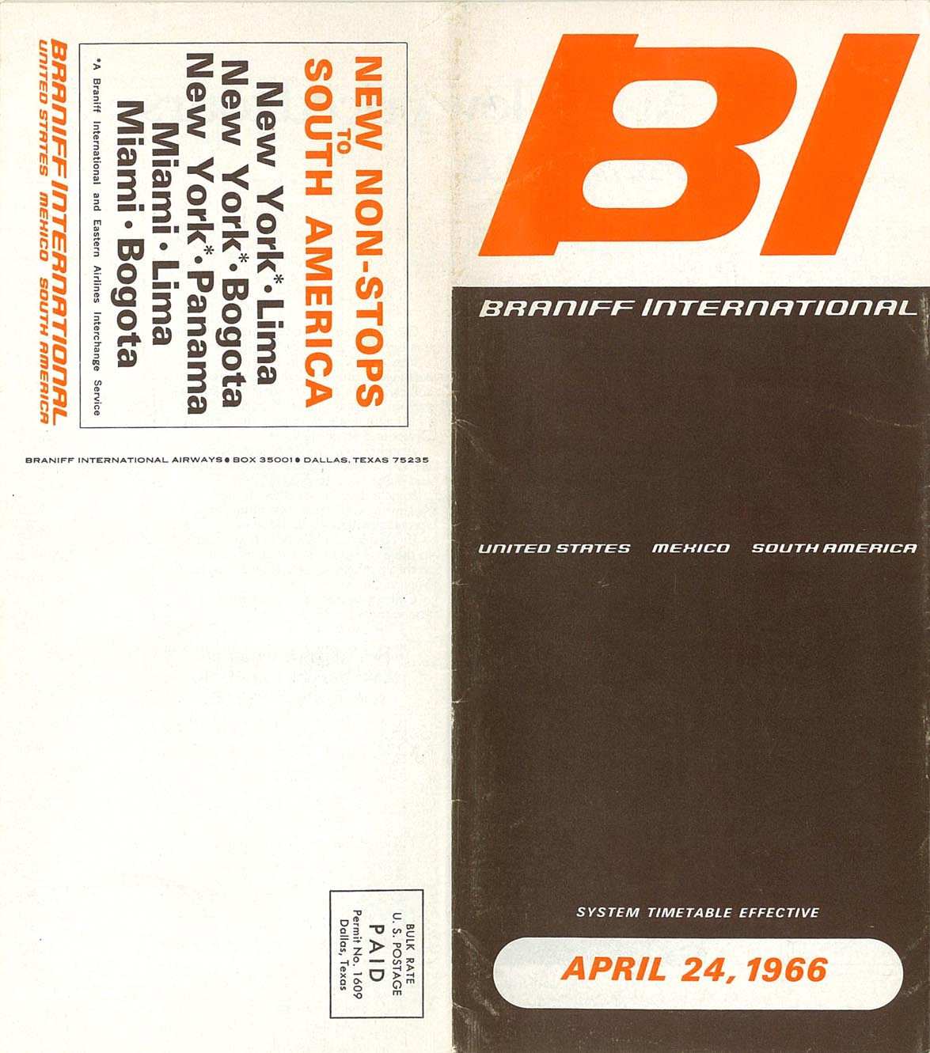
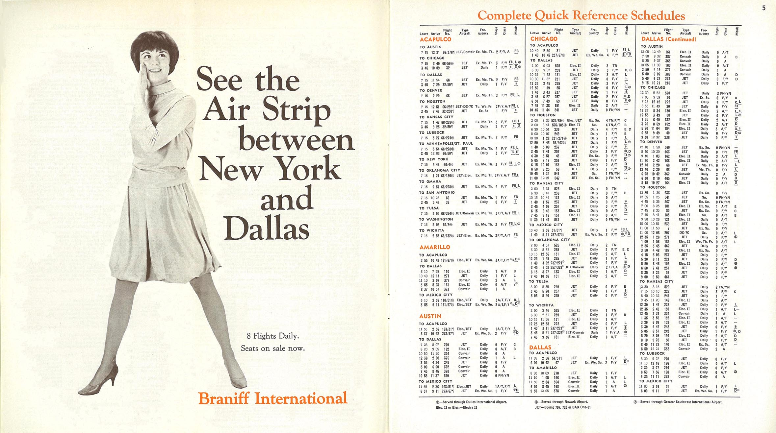
BRANIFF INTERNATIONAL AIRWAYS
FLIGHT 250 DAILY SCHEDULE

Slide 22
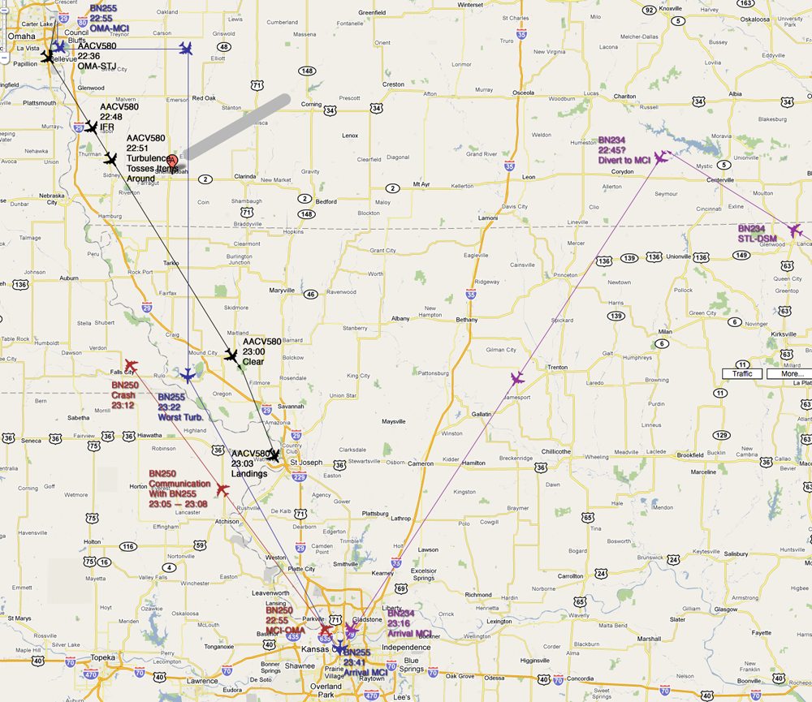

Slide 23
Cockpit Voice Recorder
First accident ever to be recorded after US mandate.
Flight Data Recorder destroyed.

Slide 24
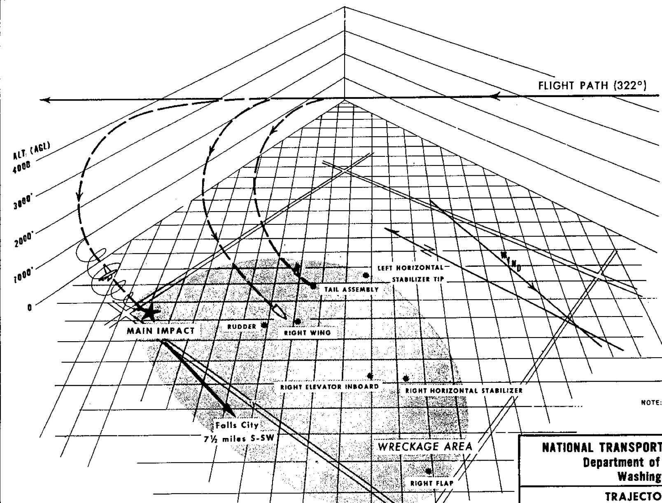

Slide 25
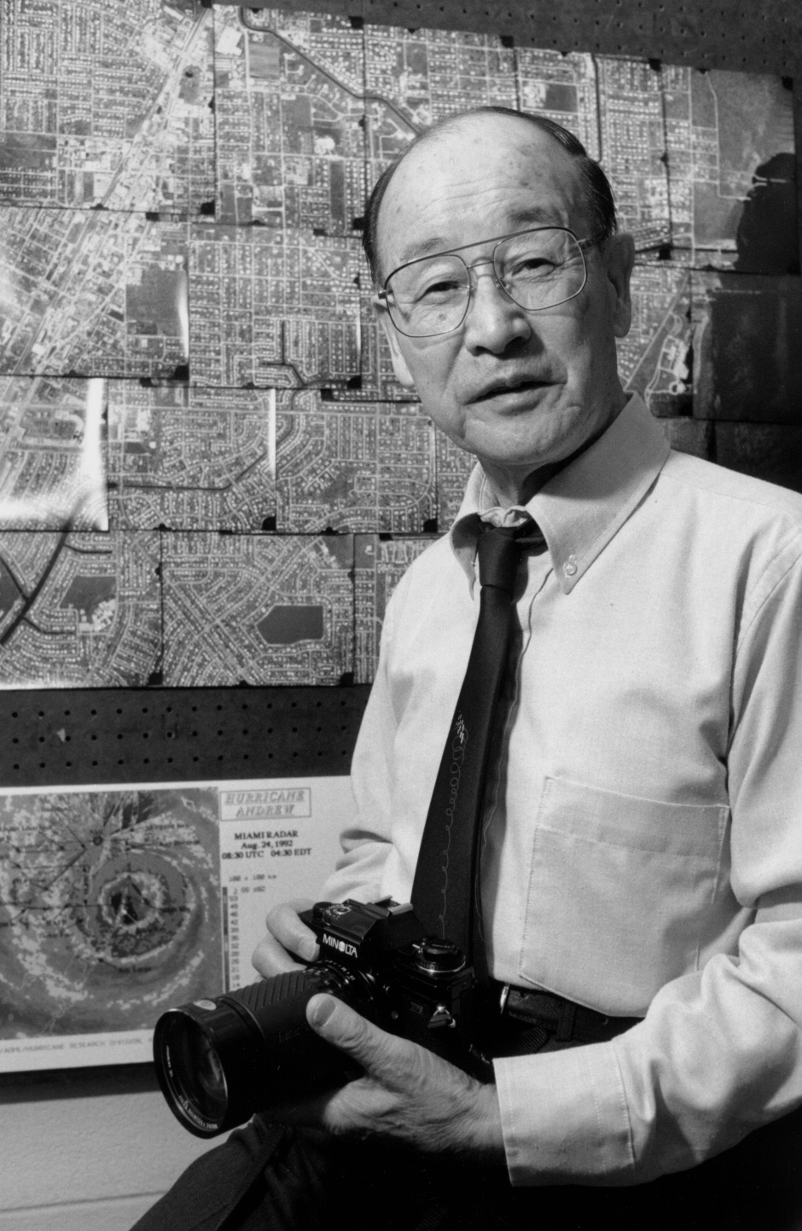
DR. TETSUYA THEODORE “TED” FUJITA
MR. TORNADO

Slide 26
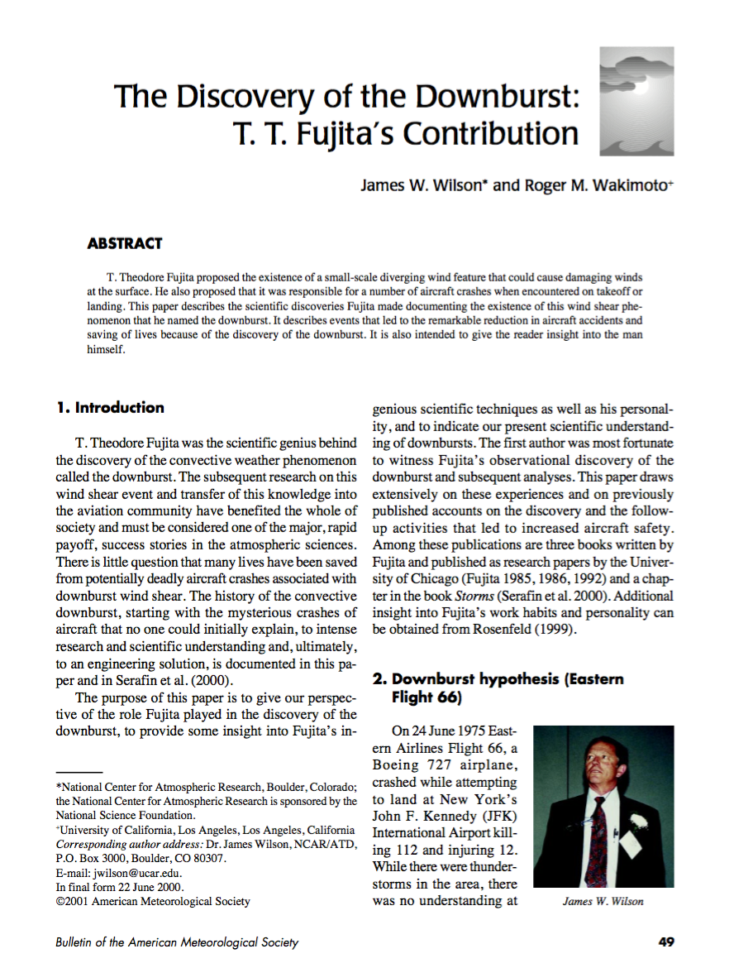
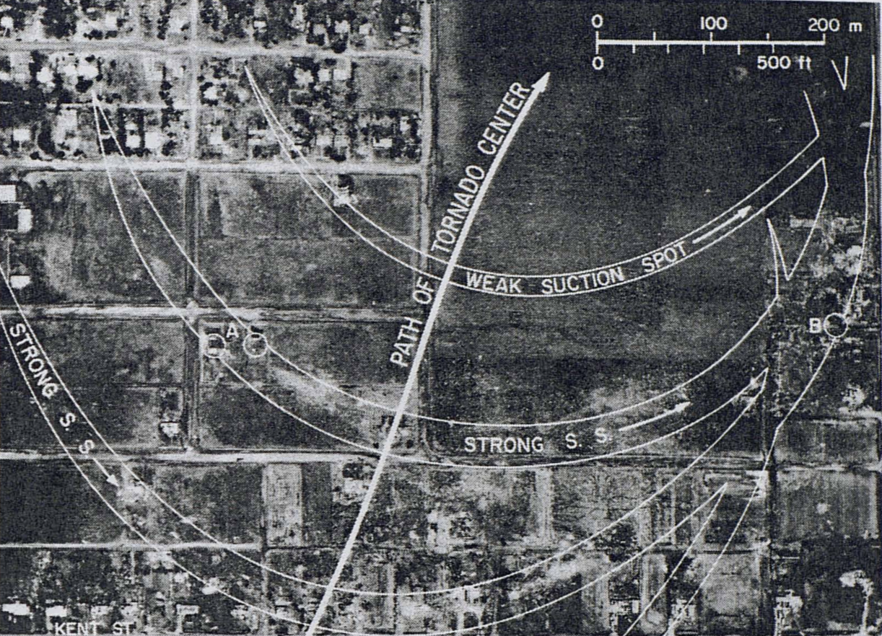
TORNADO AND MICROBURST RESEARCH
DR. TED FUJITA

Slide 27
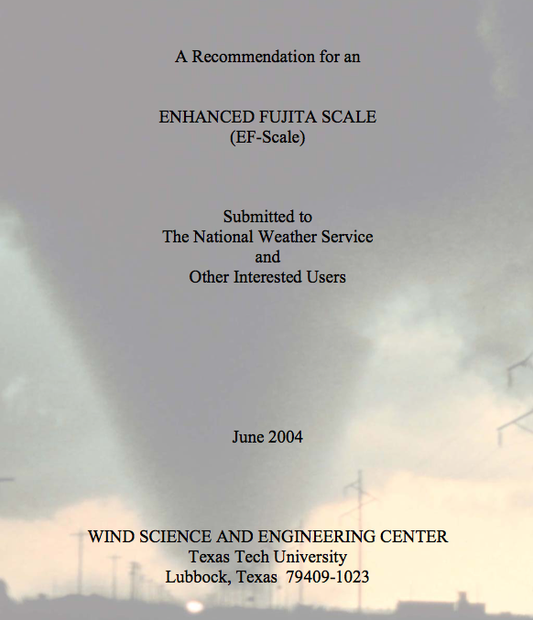
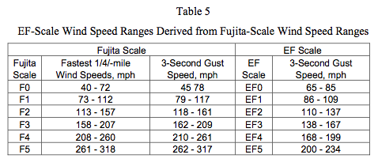
EF Scale

Slide 28
Dr. Fujita’s Publications Regarding BN250
Three reports:
Fujita, T., 1966a. Detailed investigation of mesometeorological conditions of the squall line of August 6-7, 1966 which crossed the air route between Kansas City, Missouri and Omaha, Nebraska, part I: Text and figures: Prepared for British Aircraft Corporation (U.S.A.), Inc., 29 pp. [November, 1966]
Fujita, T., 1966b. Detailed investigation of mesometeorological conditions of the squall line of August 6-7, 1966 which crossed the air route between Kansas City, Missouri and Omaha, Nebraska, part II: References – Reproductions: Prepared for British Aircraft Corporation (U.S.A.), Inc., 30 pp. [November, 1966]
Fujita, T., 1967a. Detailed investigation of mesometeorological conditions of the squall line of August 6-7, 1966 which crossed the air route between Kansas City, Missouri and Omaha, Nebraska, part III: Turbulence in relation to the squall line: Prepared for British Aircraft Corporation (U.S.A.), Inc., 27 pp. [March, 1967]

Slide 29
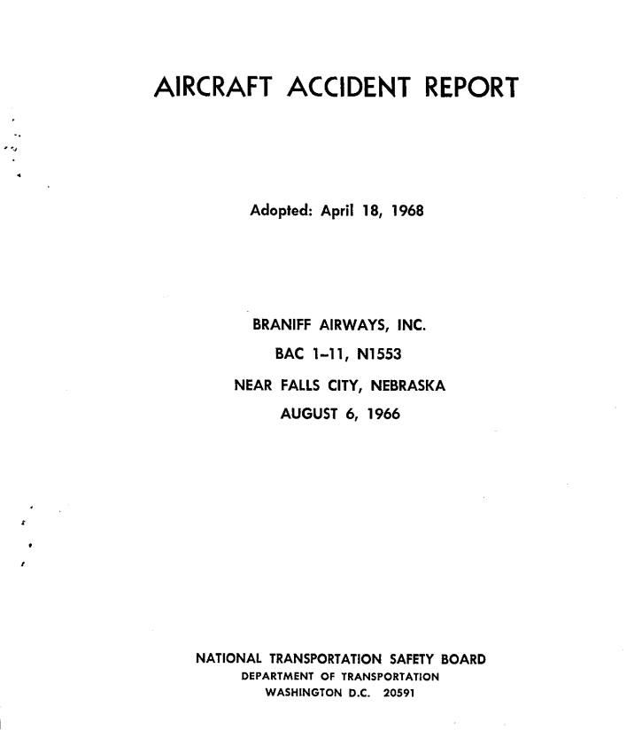
Investigation

Slide 30
PROBABLE CAUSE
“The Board determines that the probable cause of this accident was inflight structural failure caused by extreme turbulence during operation of the aircraft in an area of avoidable hazardous weather.”
BRANIFF 250

Slide 31
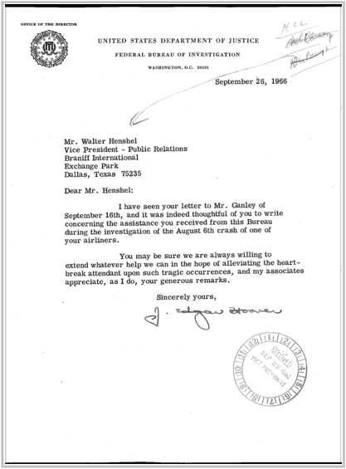
THANKS FROM THE FBI
J. EDGAR HOOVER
SEPT. 26, 1966

Slide 32
PHOTOS
SOME MAY BE DISTURBING.

Slide 33
BAC 1-11 N1553
MINNEAPOLIS- ST. PAUL INTERNATIONAL AIRPORT
SUMMER 1966

Slide 34
BAC 1-11 N1553
DALLAS LOVE FIELD, SUMMER 1966

Slide 35
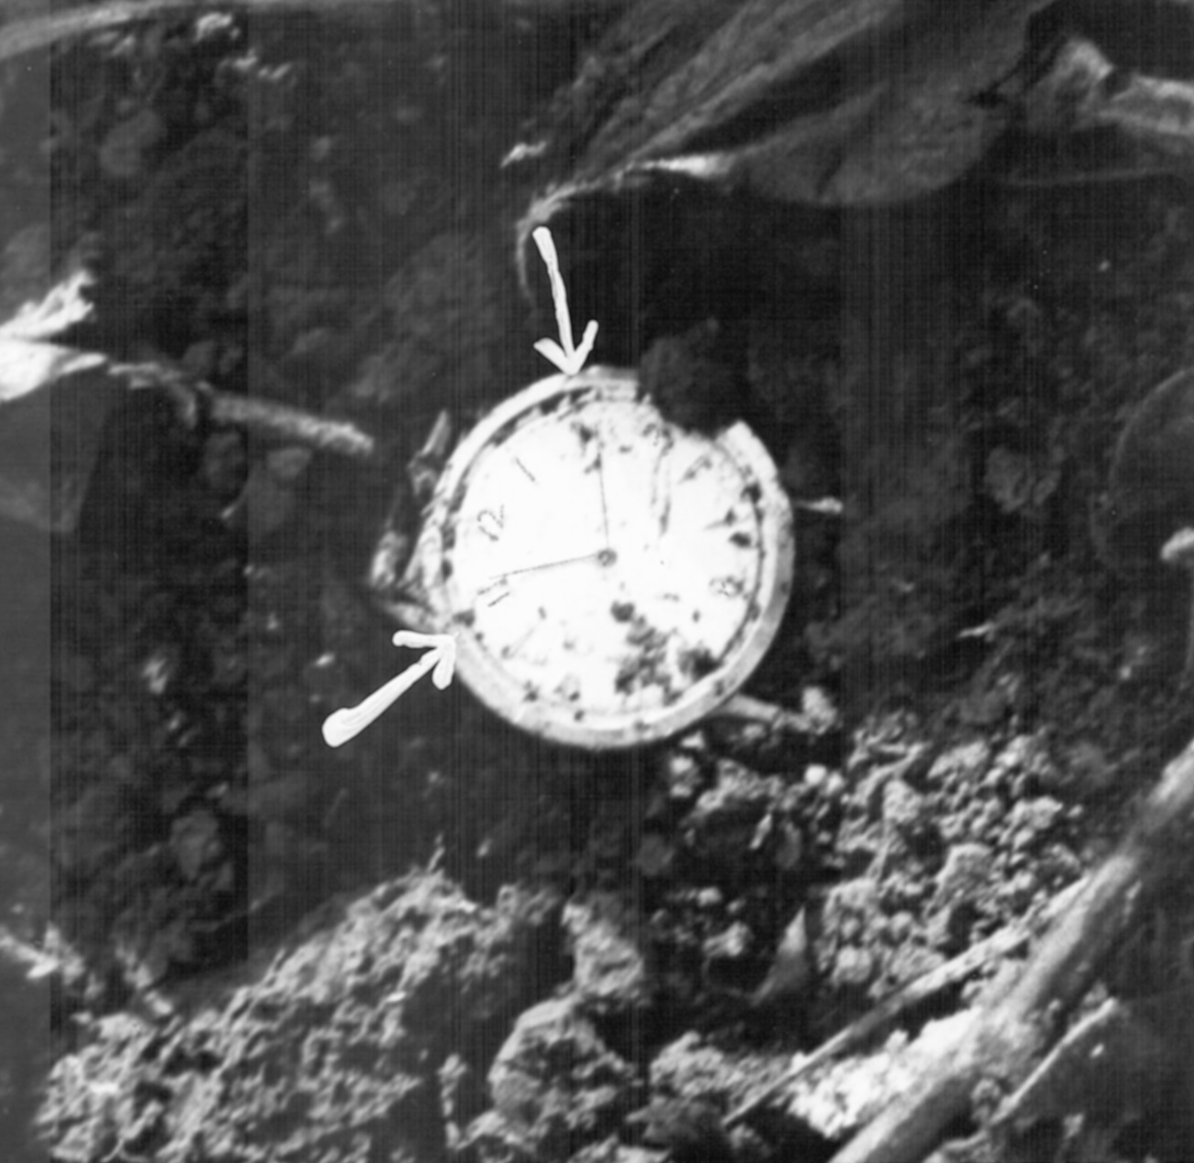
WATCH STOPPED AT TIME OF IMPACT; FOUND AT SITE.
BILL SCHOCK, FCJ

Slide 36
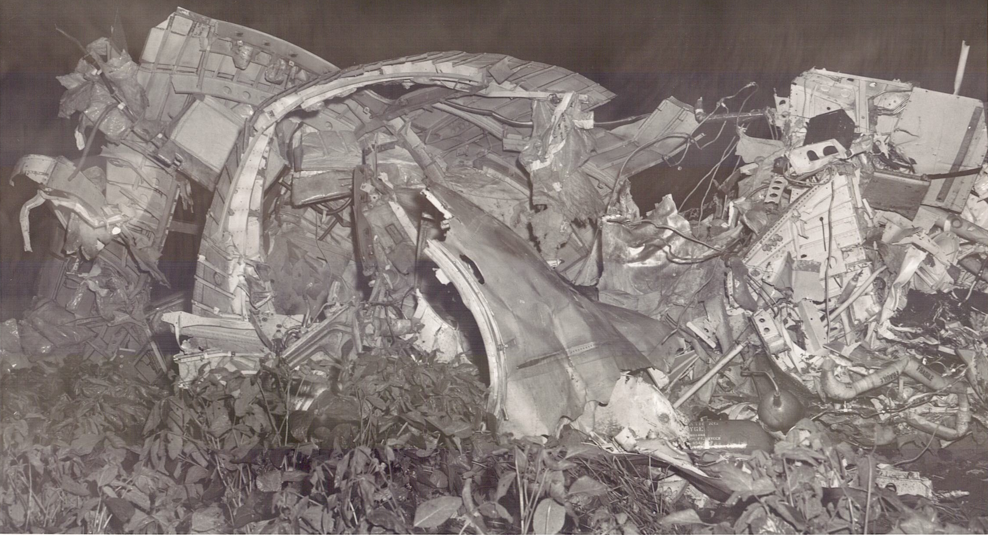
FL250’S NOSE SECTION, TOP
TAKEN ON FIRST ARRIVAL AT SITE

Slide 37
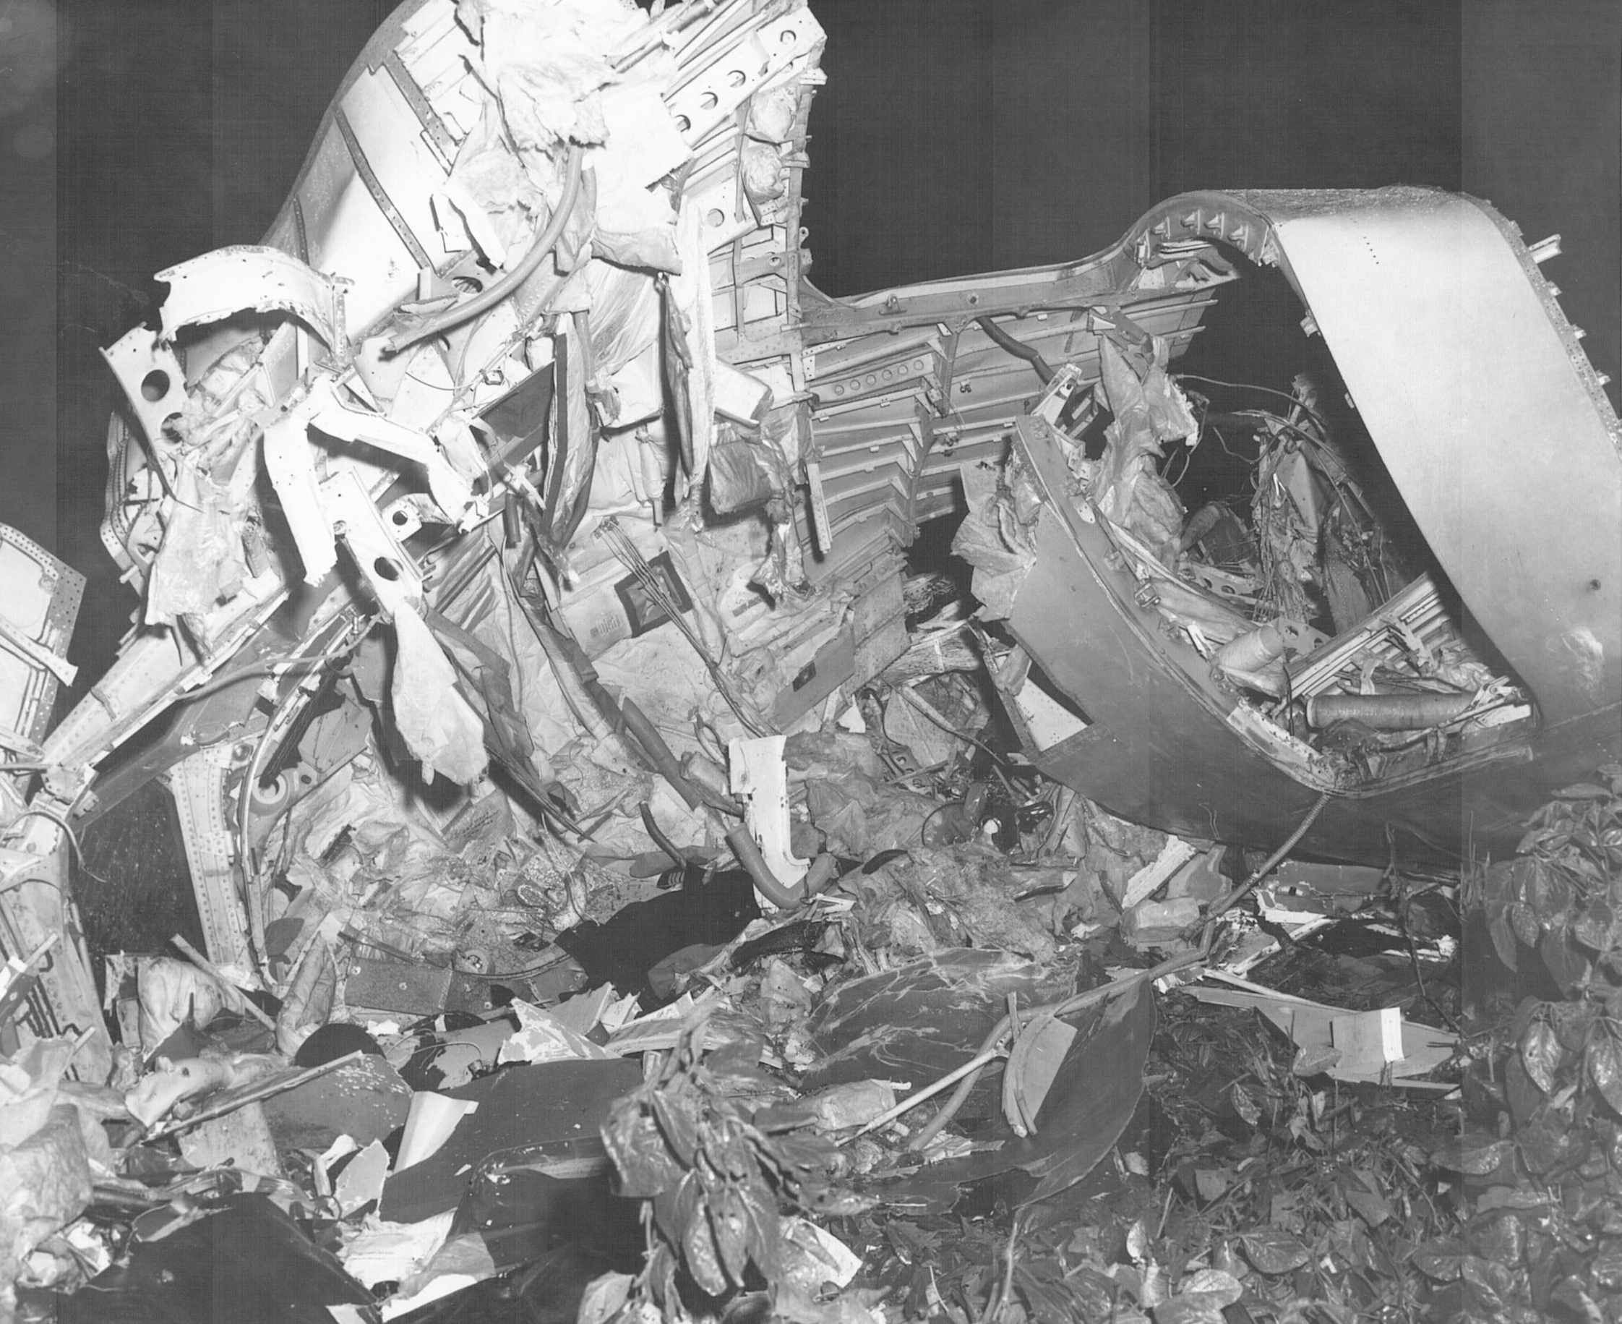
COCKPIT AND FRONT DOOR
ALSO TAKEN ON FIRST ARRIVAL AT SITE

Slide 38
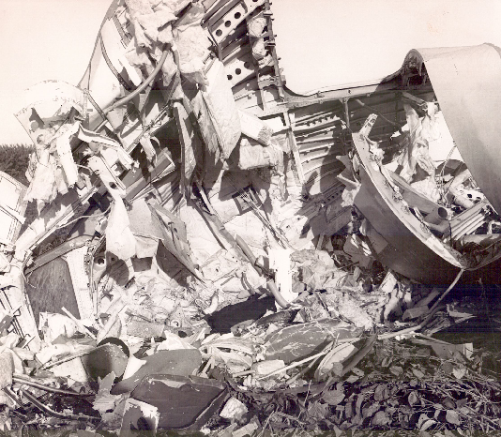
DAWN BREAKS; COCKPIT ROOF
TAKEN JUST AFTER SUNRISE

Slide 39
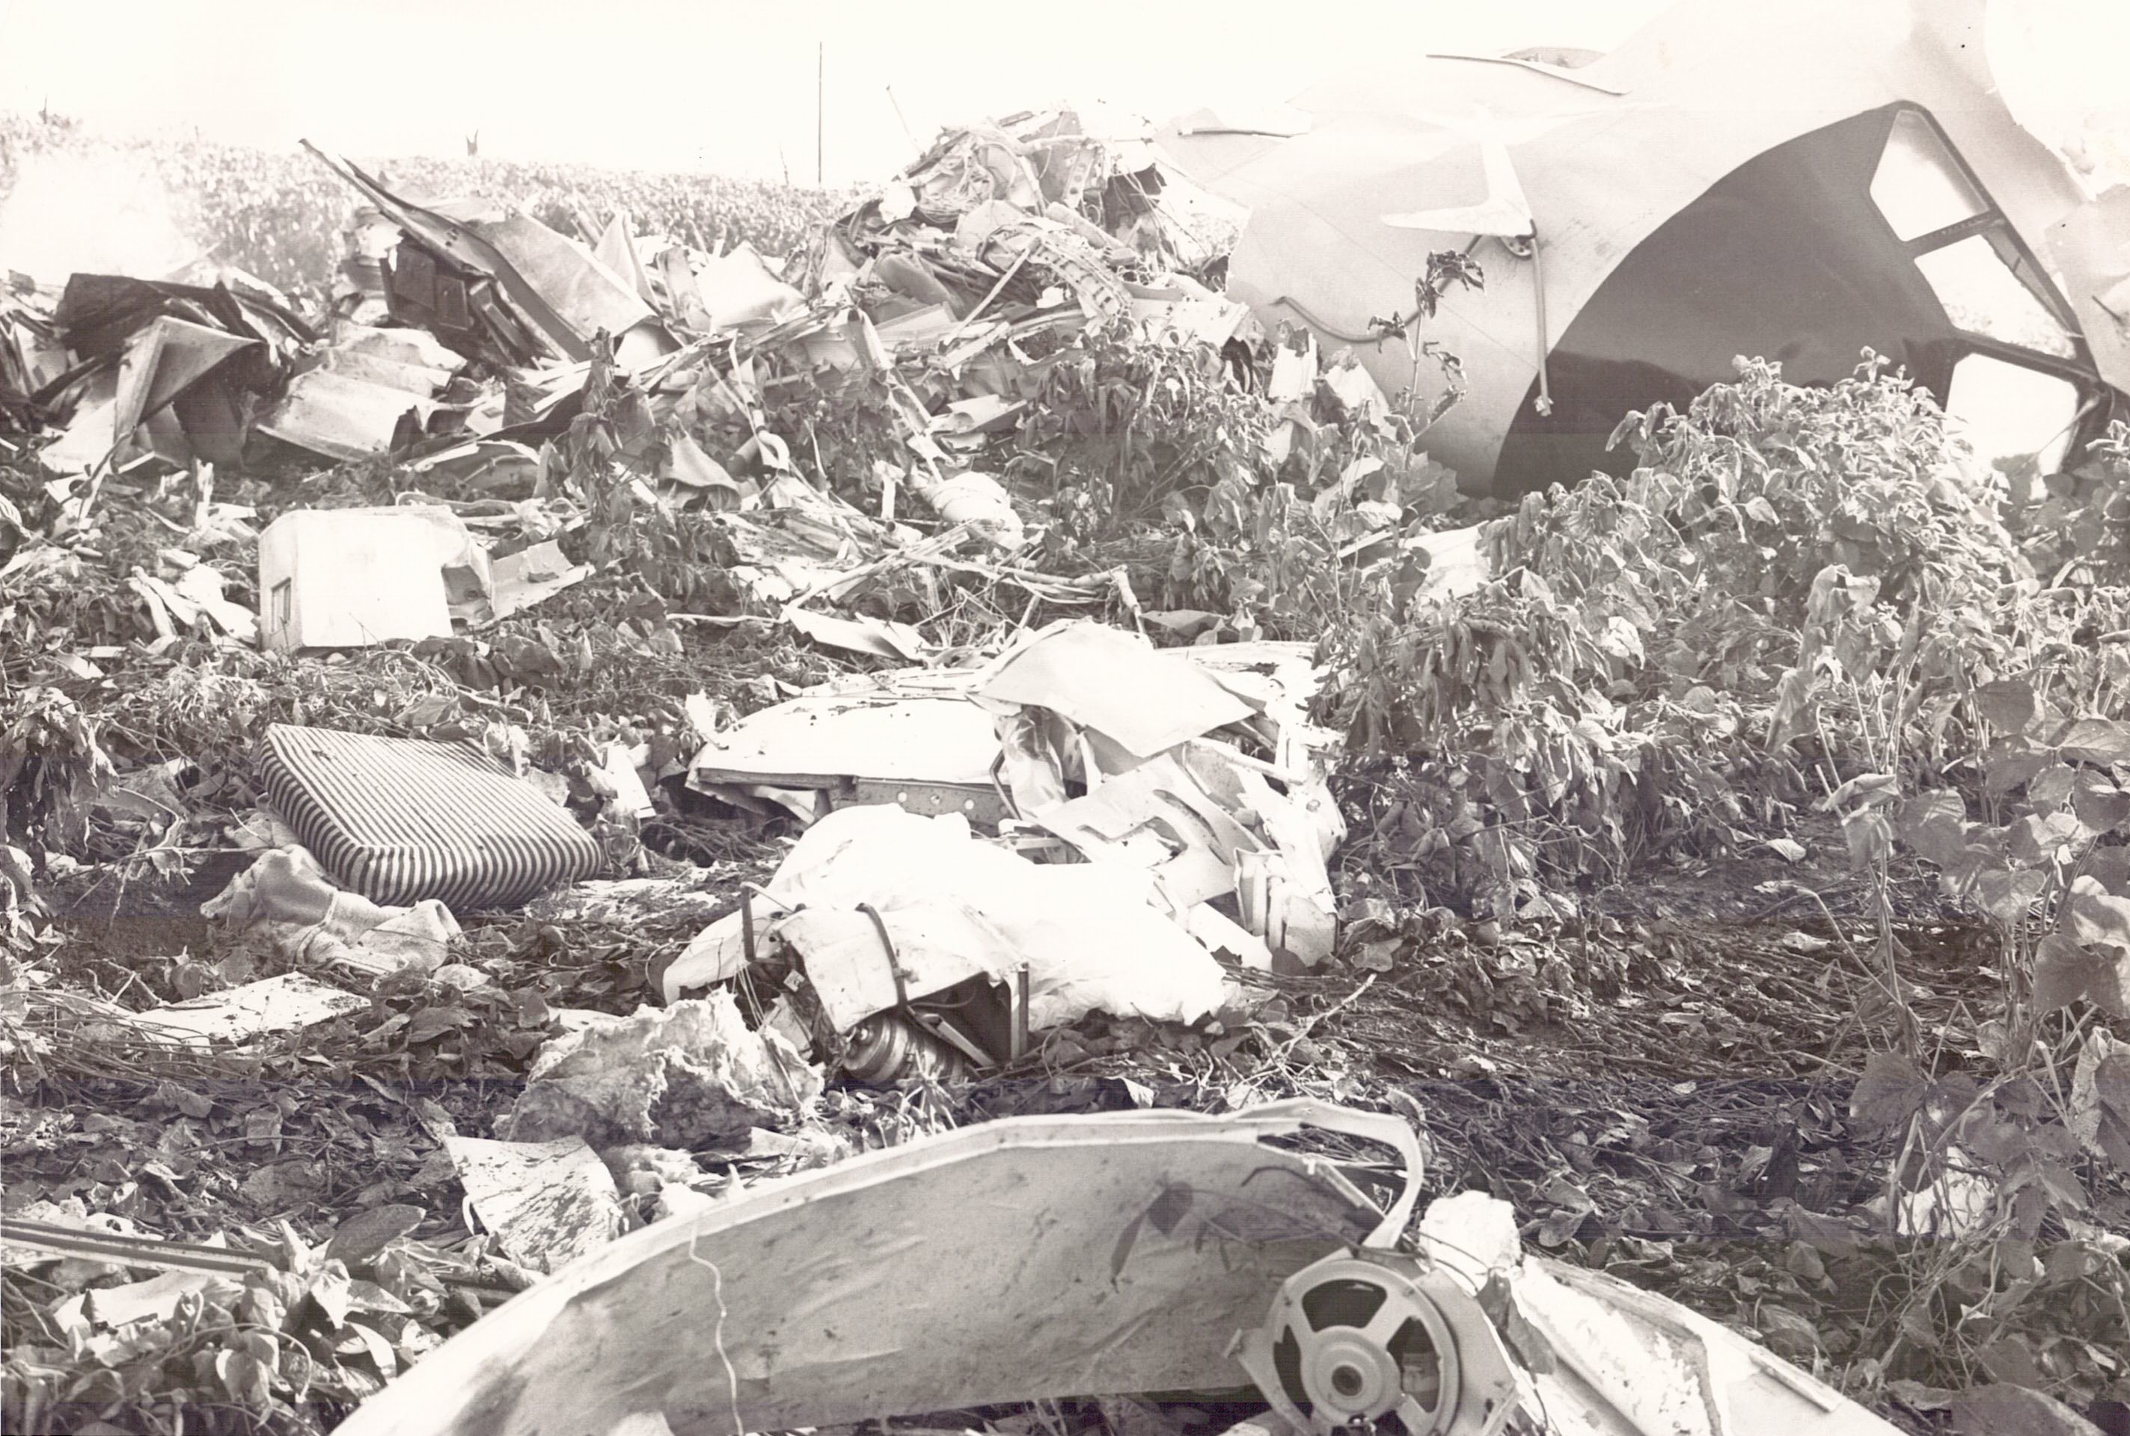
WRECKAGE; COCKPIT ROOF
SHOWS ALEXANDER GIRARD-DESIGNED SEATS

Slide 40
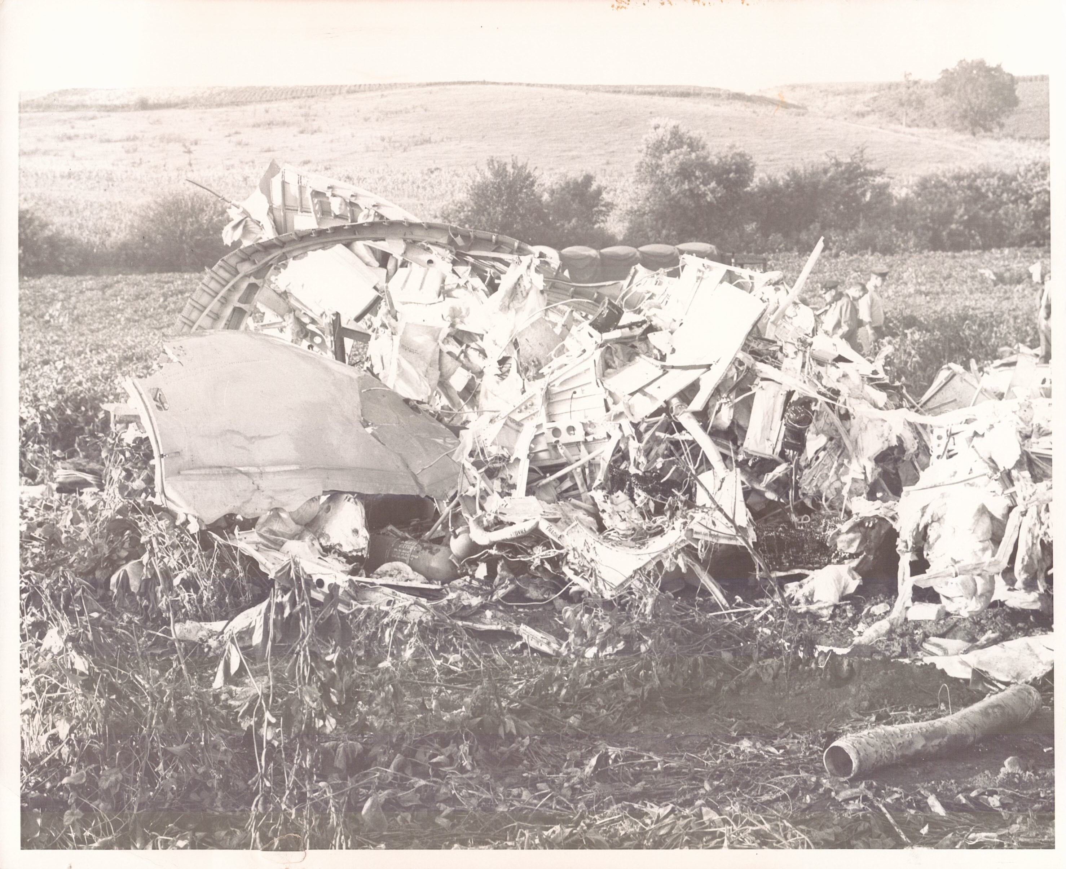
GENERAL WRECKAGE VIEW
ARMY TRUCK AND SEARCHERS BEHIND

Slide 41
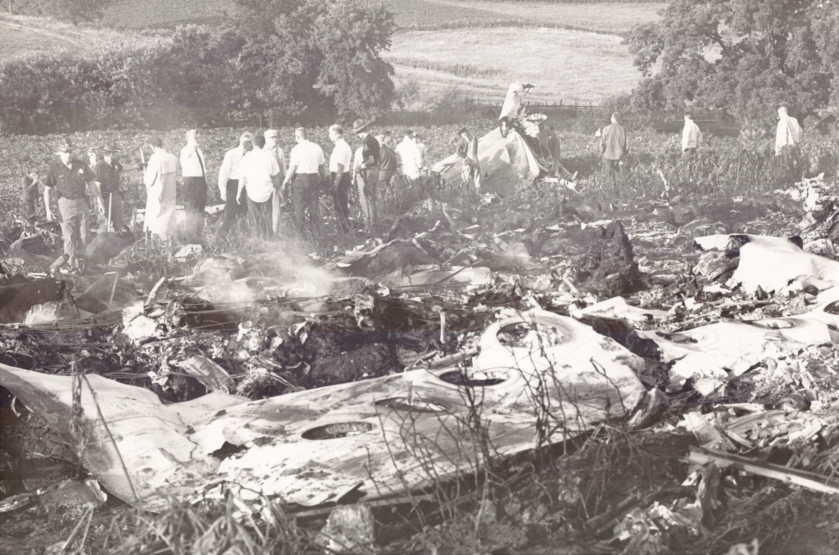
SURVEYING THE SITE
FIRST RESPONDERS

Slide 42
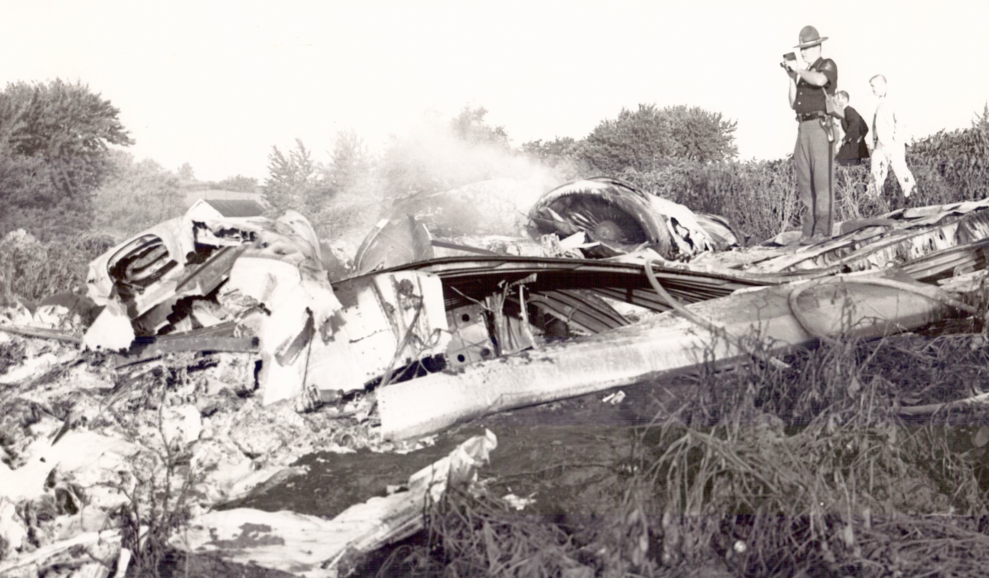
TROOPER FILMING SITE
STANDING ON NO. 1 (LEFT) ROLLS-ROYCE SPEY ENGINE

Slide 43
RIGHT WING, UPSIDE DOWN
ONE OF FIRST PIECES TO SEPARATE FROM THE AIRCRAFT

Slide 44
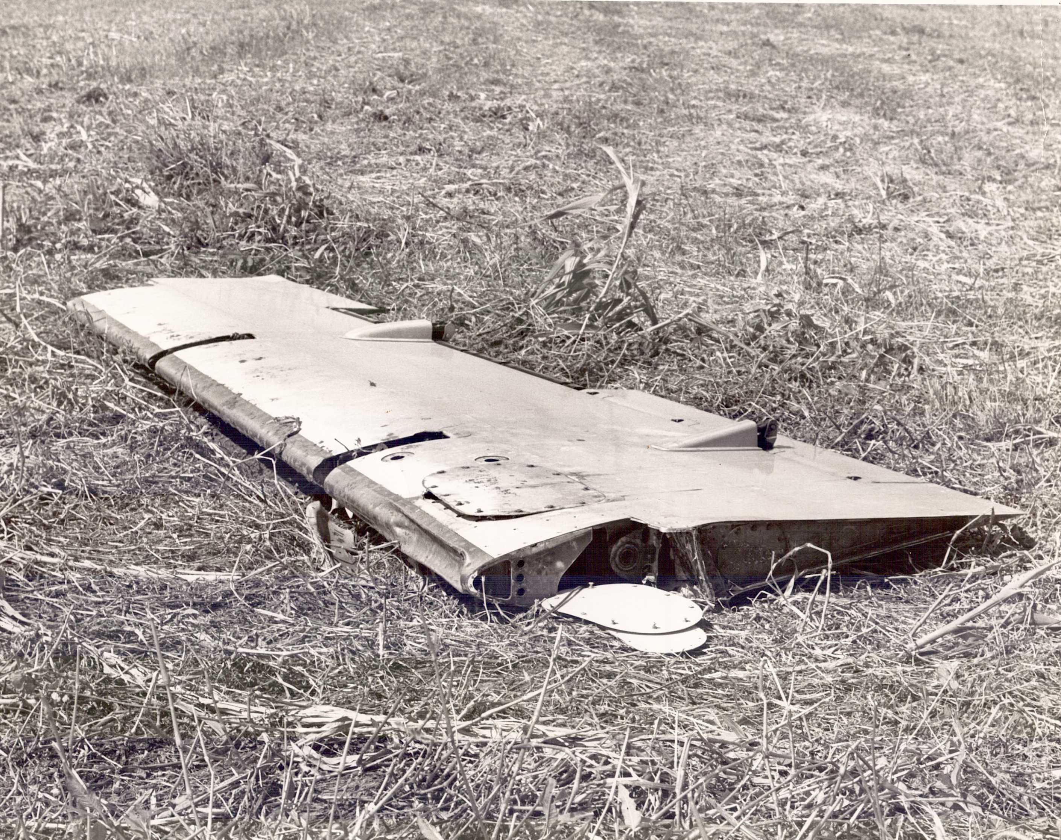
LEFT ELEVATOR
FAR FROM MAIN CRASH SITE

Slide 45
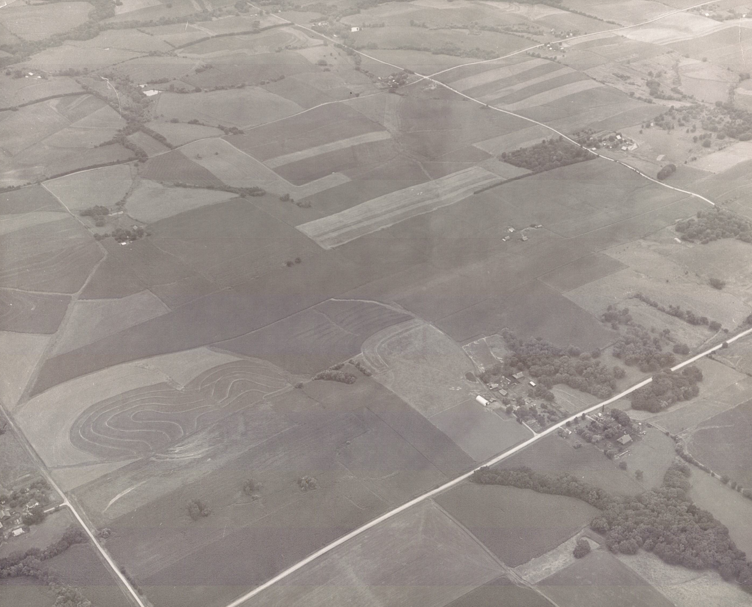
AERIAL SITE PHOTOS
ARMY HELICOPTER WITH
BILL SCHOCK AS PHOTOGRAPHER

Slide 46
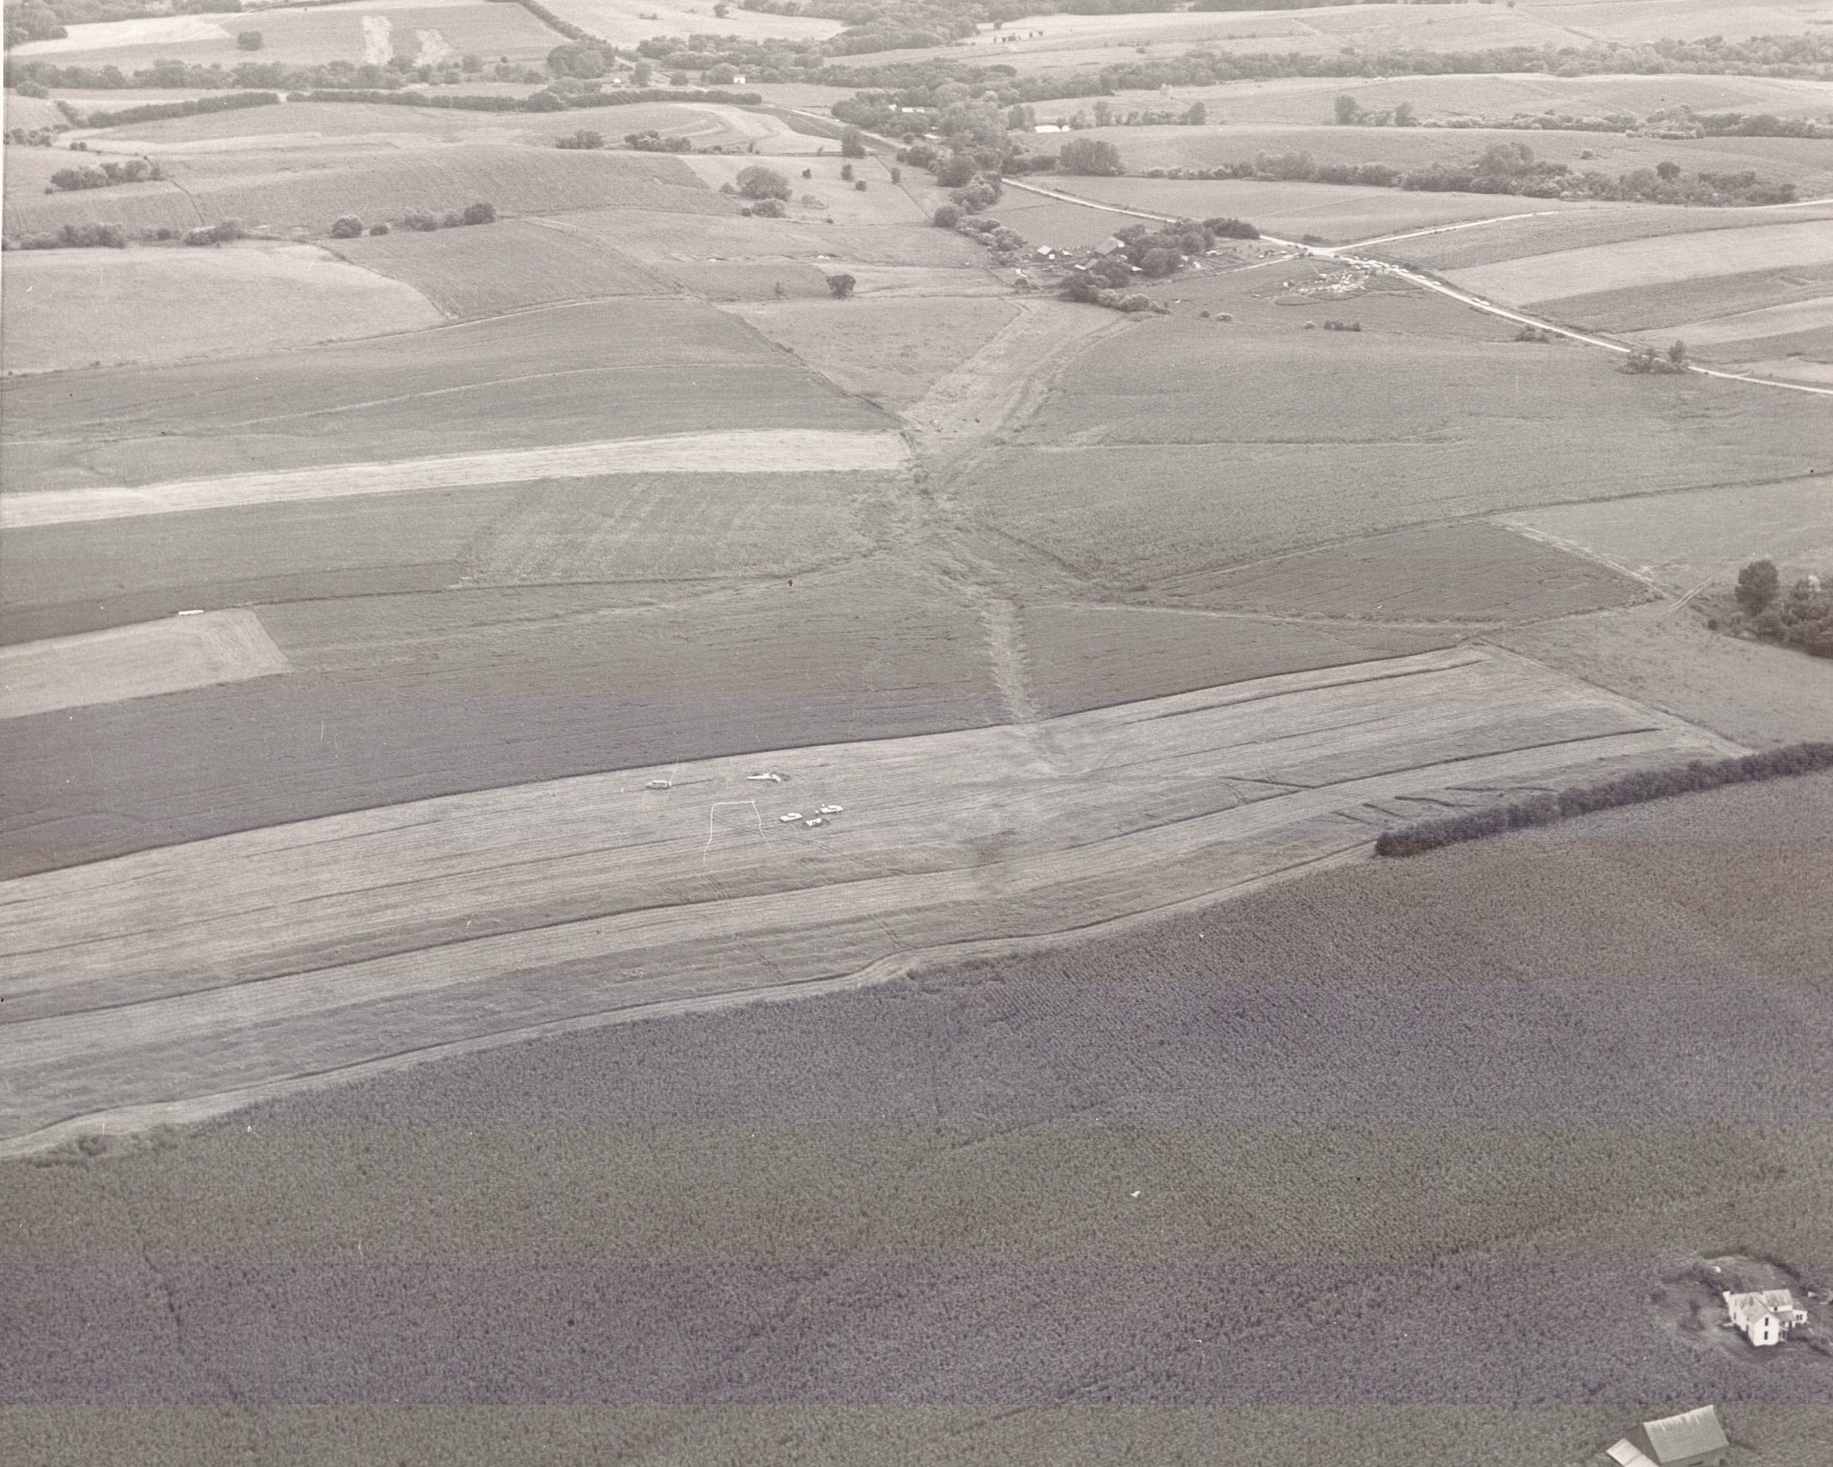
FLYING NORTHWEST
SITE IN UPPER RIGHT

Slide 47
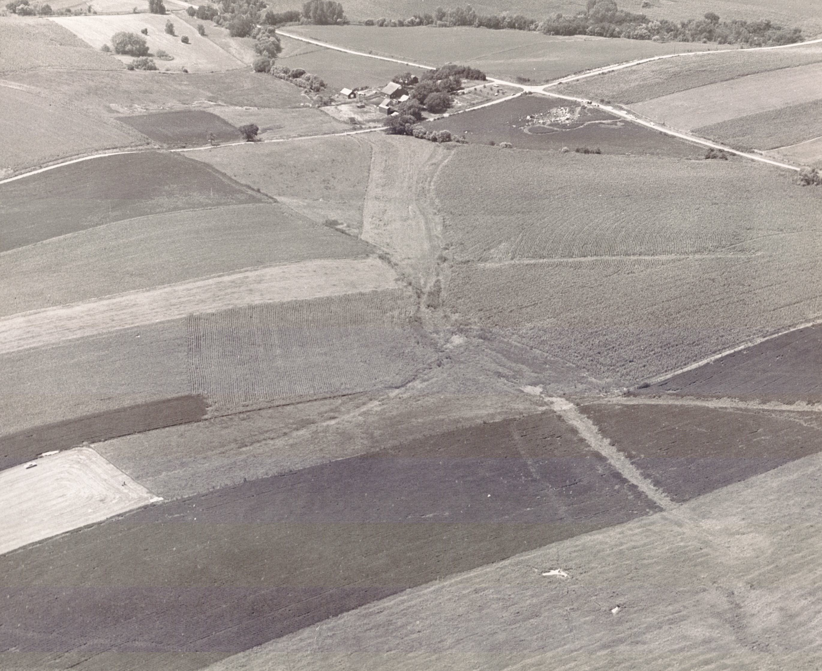
FARM AND SITE
655 / 714 INTERSECTION

Slide 48
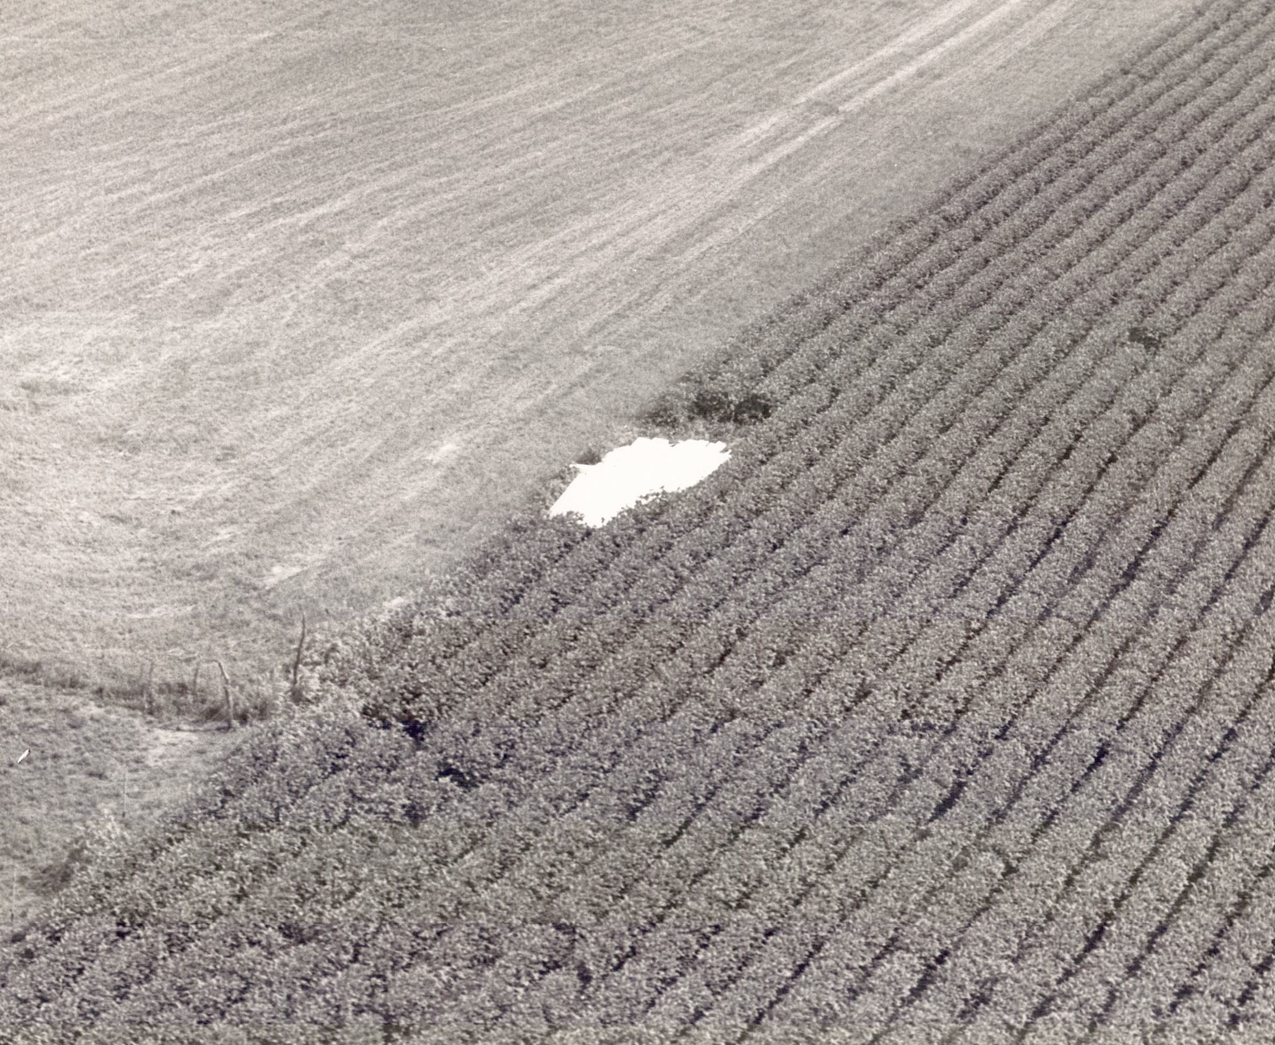
RIGHT WING LANDING SPOT
NOTICE HOW MUCH IT SLID FORWARD

Slide 49
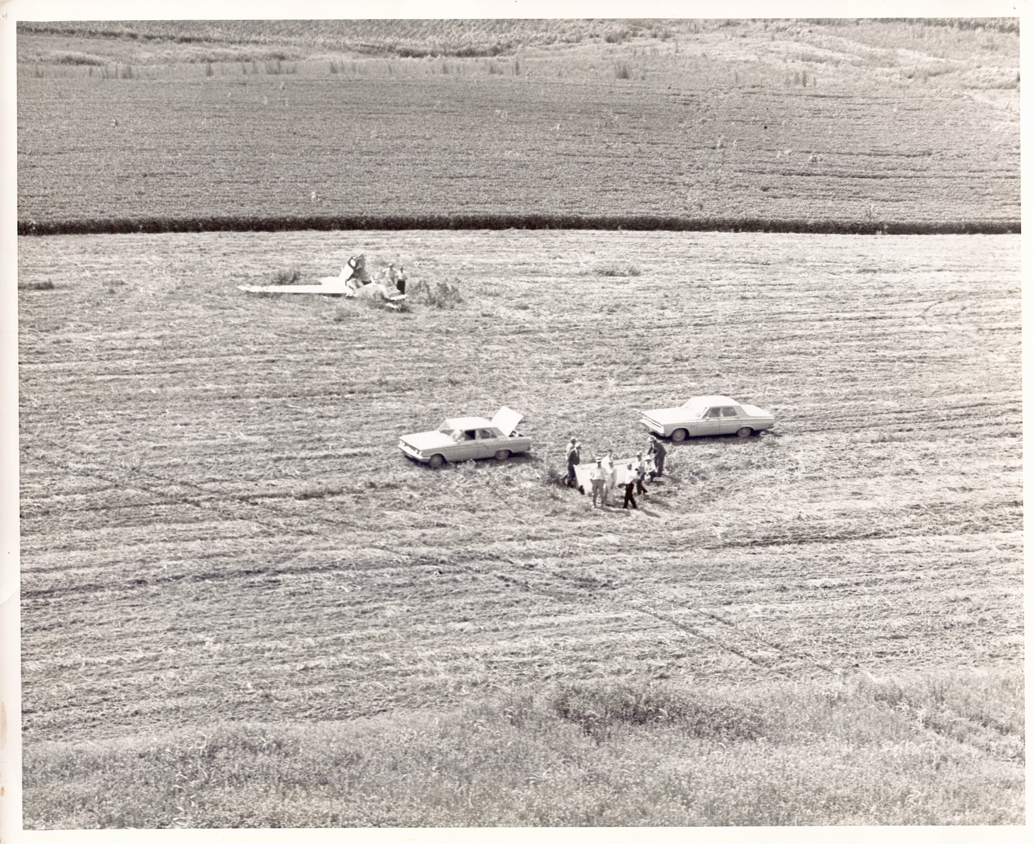
RETRIEVING EMPENNAGE
BEGINNING THE INVESTIGATION

Slide 50
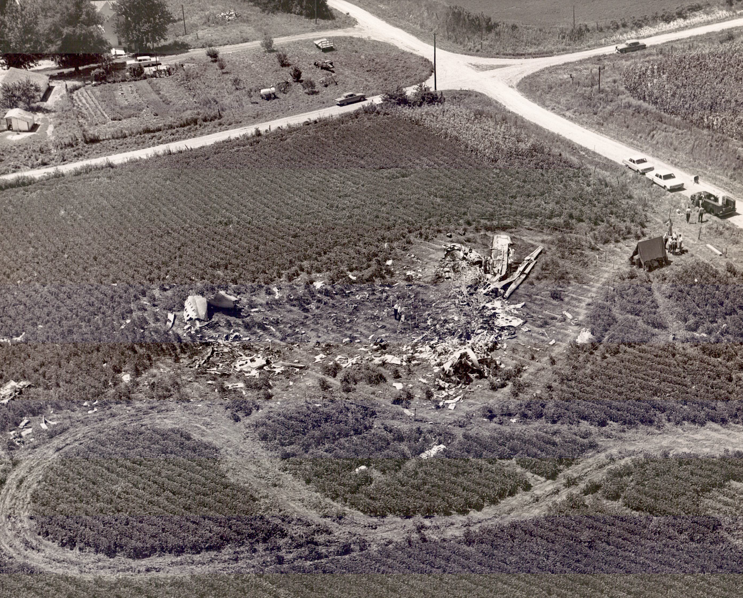
SITE ALMOST CLEANED UP
NEARLY 12 DAYS POST-CRASH

Slide 51
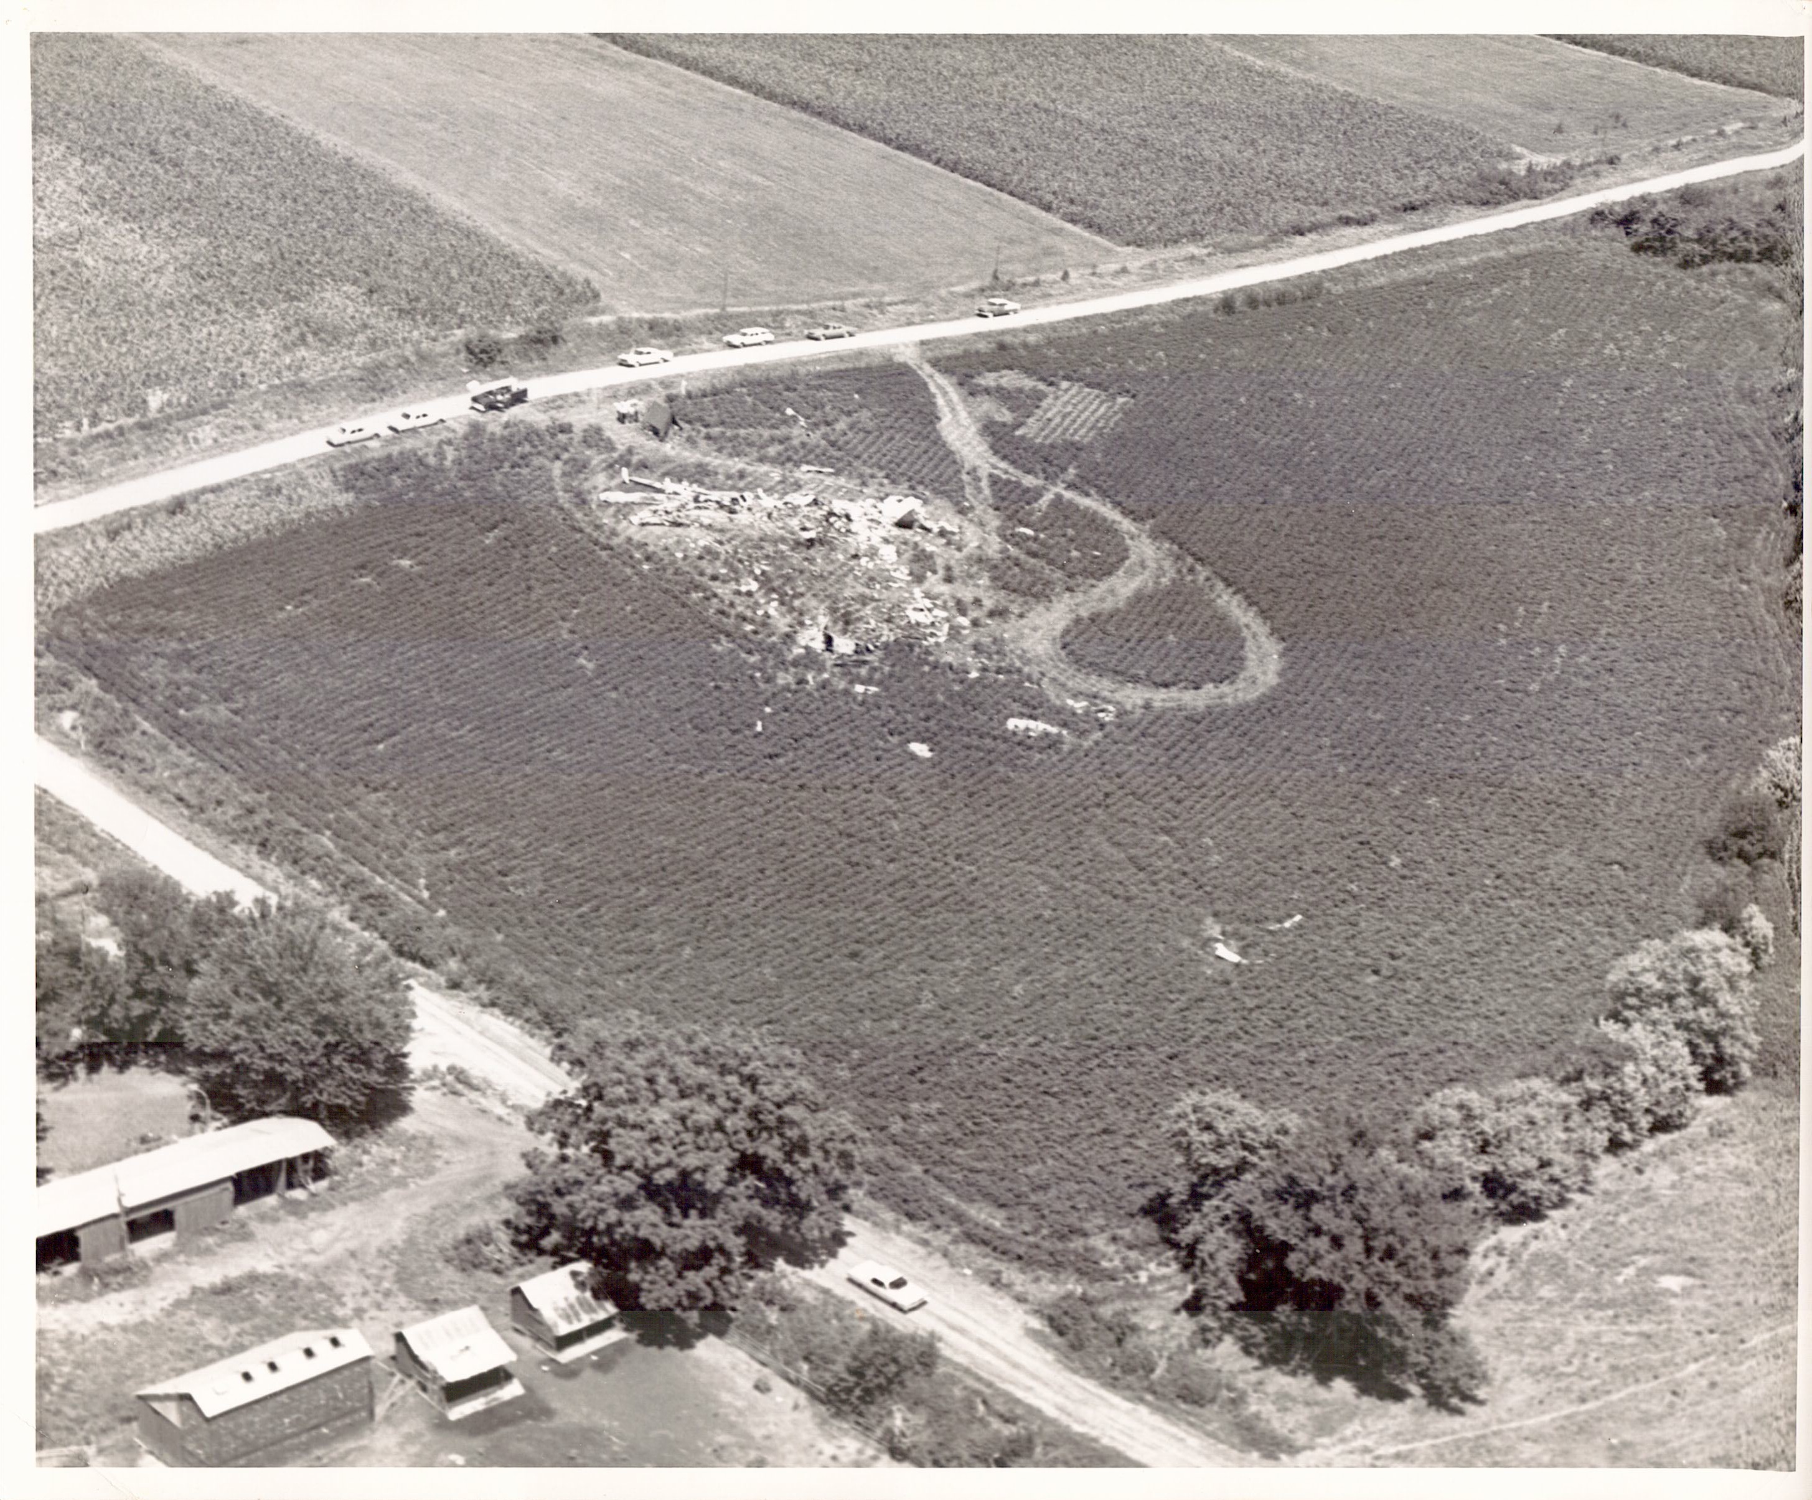
DIFFERENT ANGLE
LOOKING NORTHEAST

Slide 52
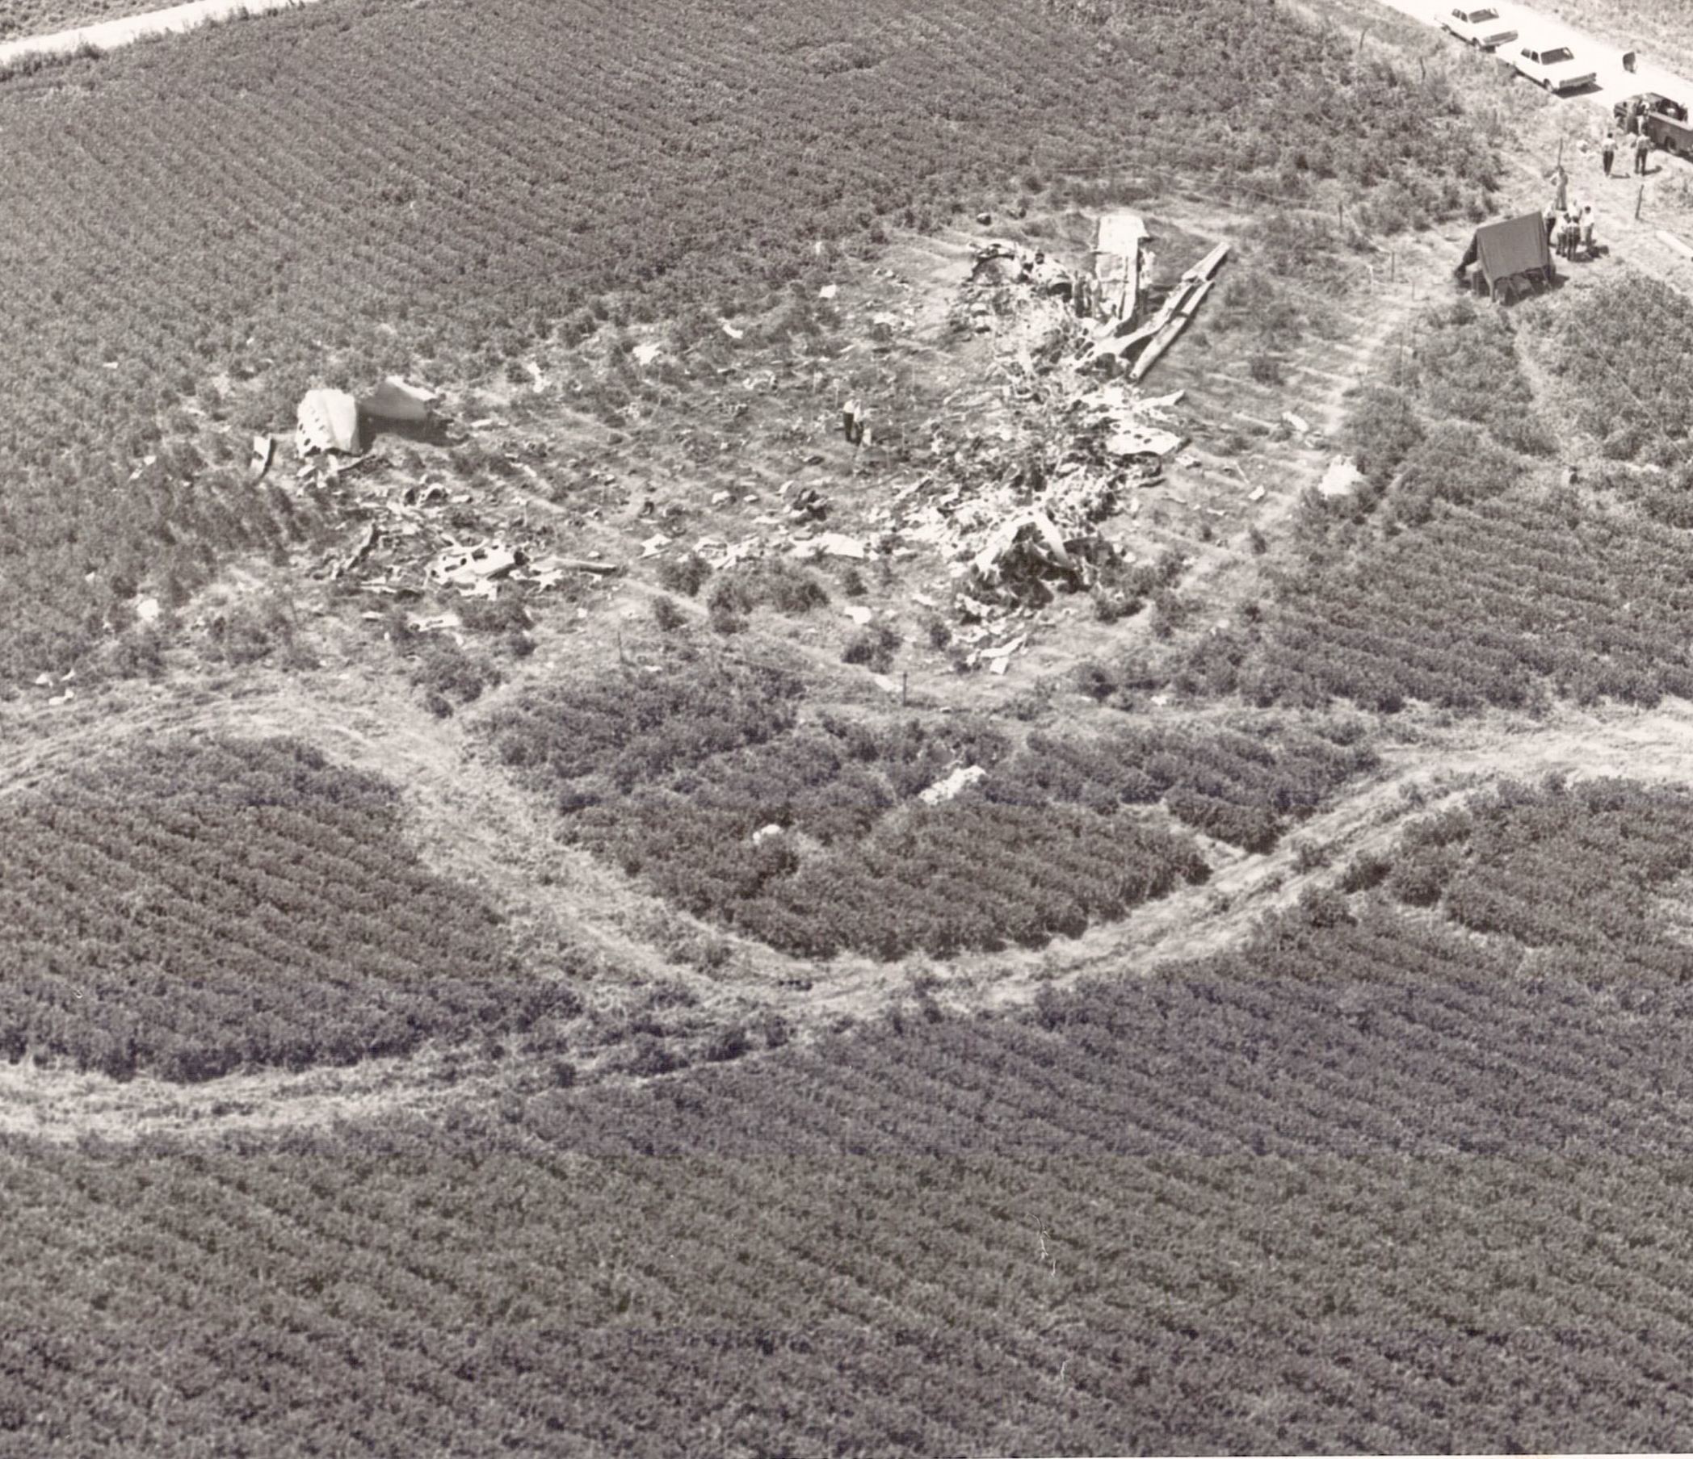
CLEANUP DETAIL
SITE NEAR END OF ORDEAL

Slide 53
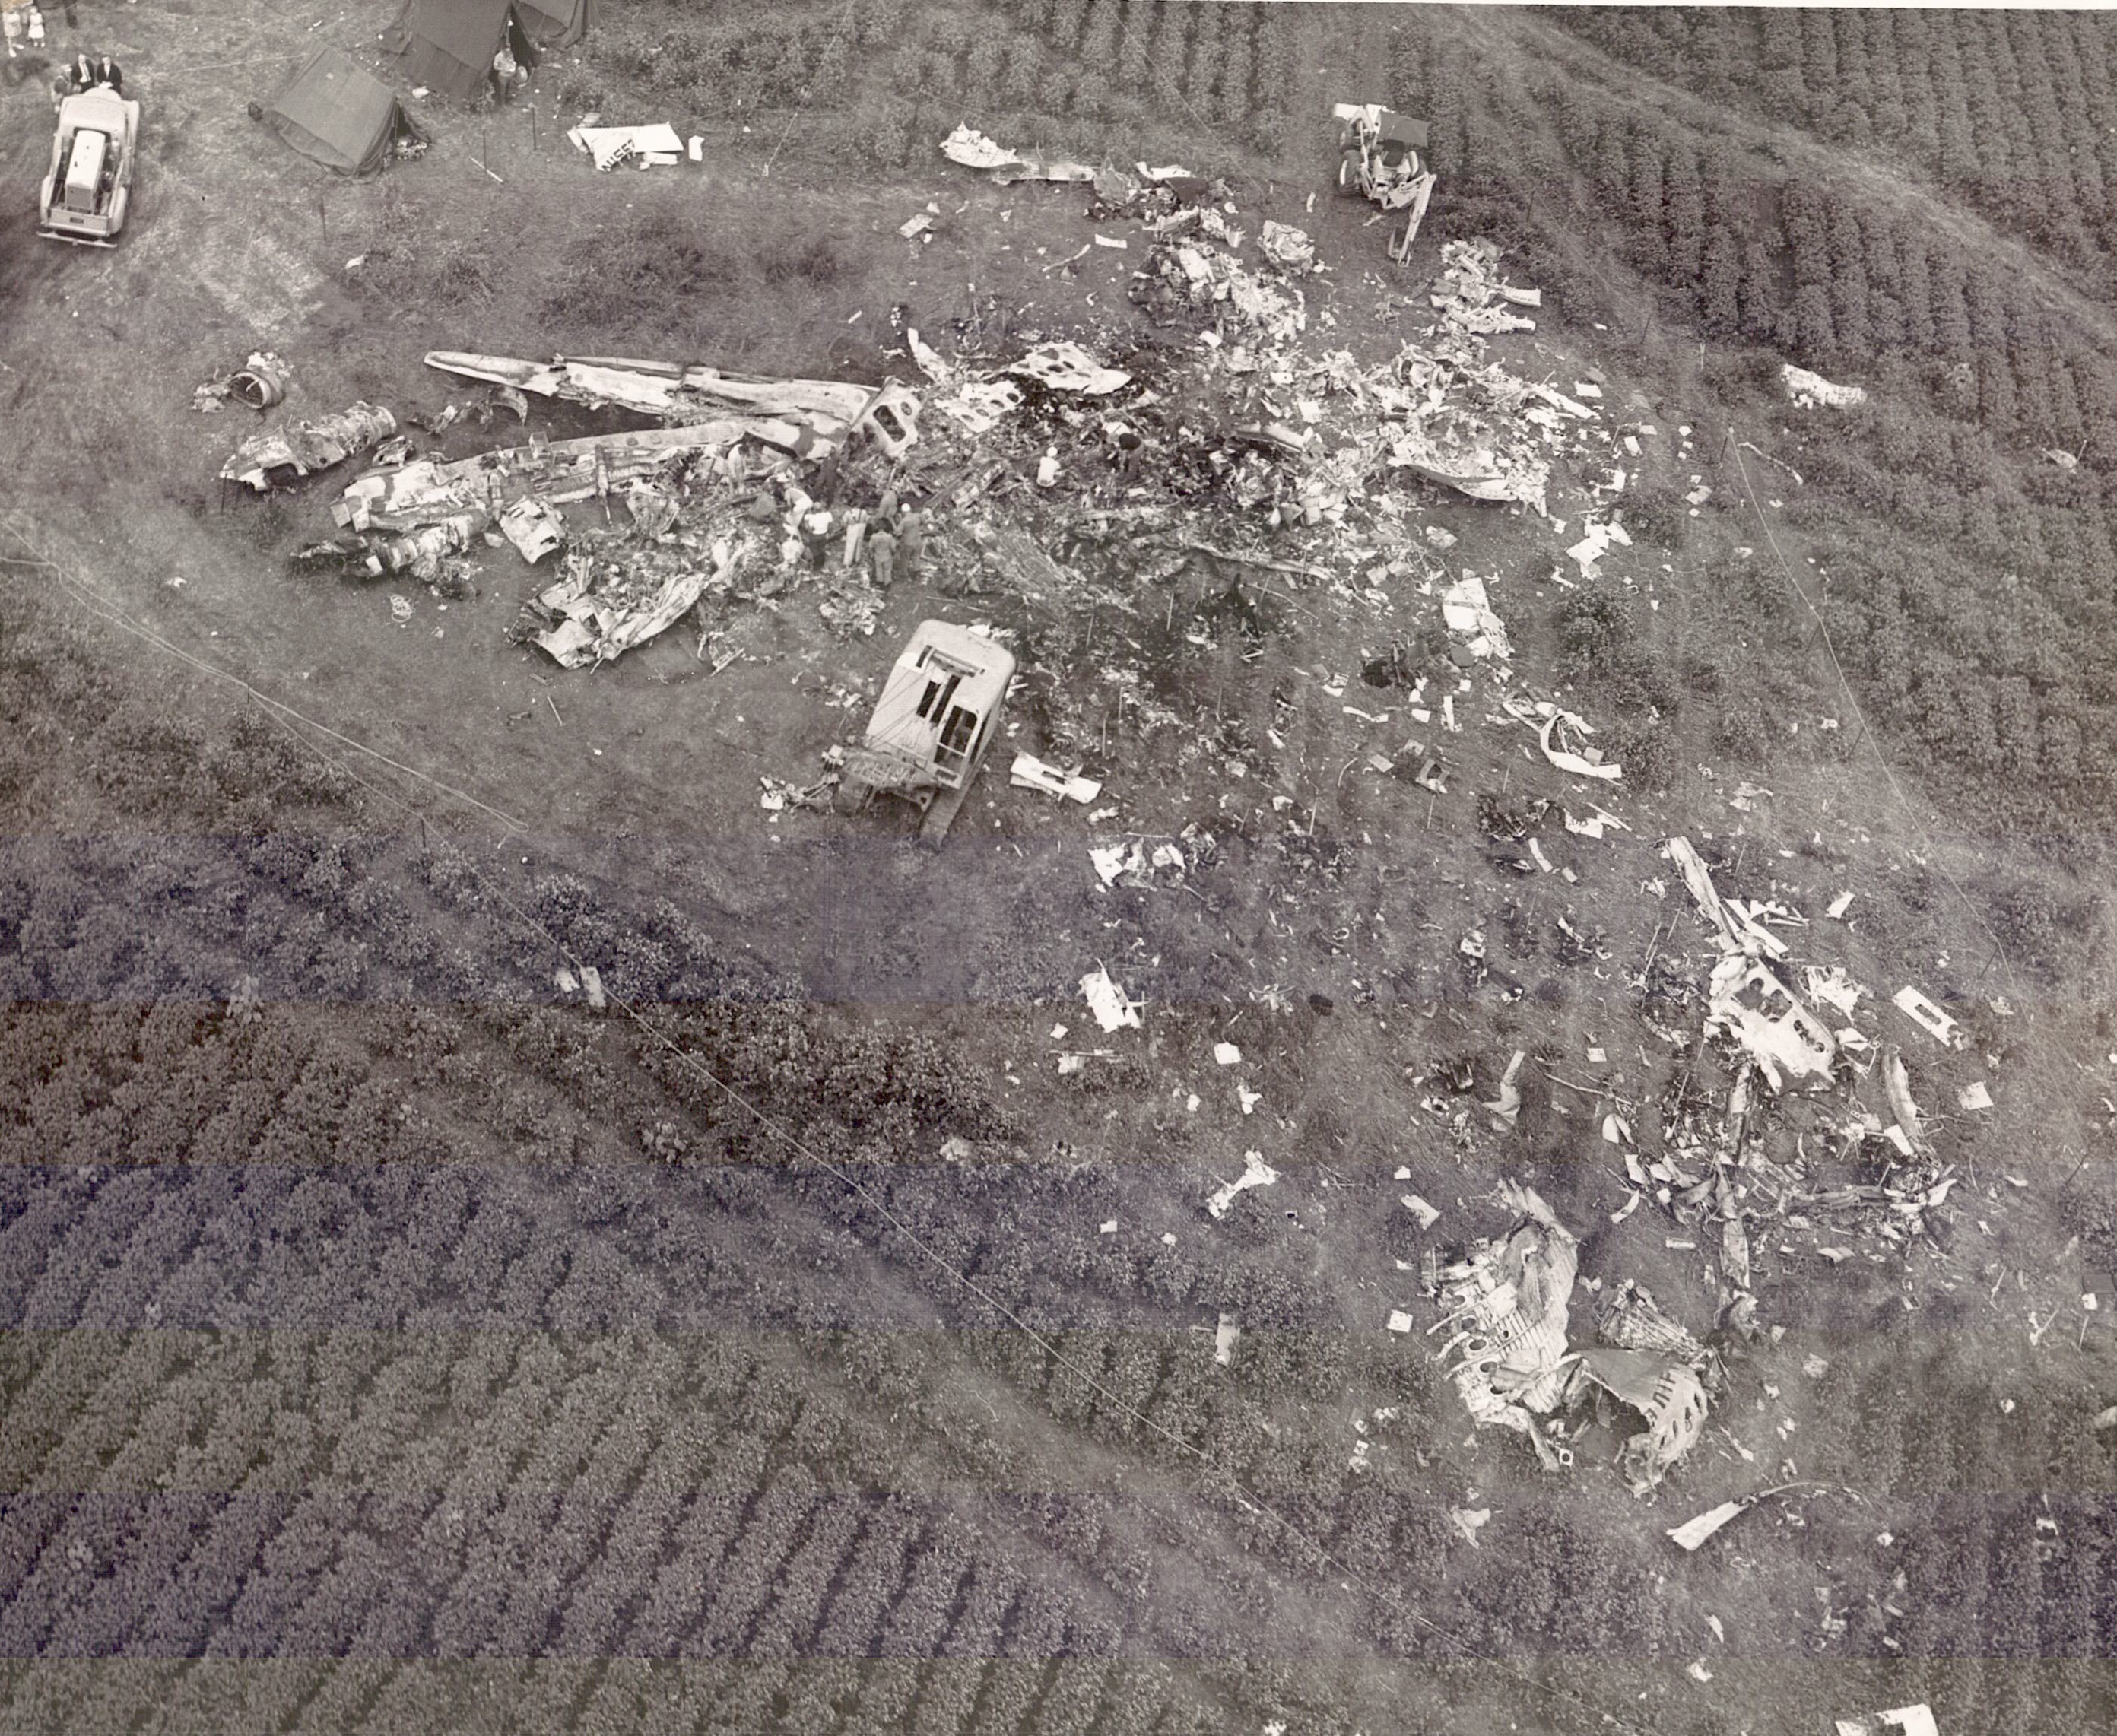
LOOKING TO THE SOUTHEAST
WING REMAINS

Slide 54
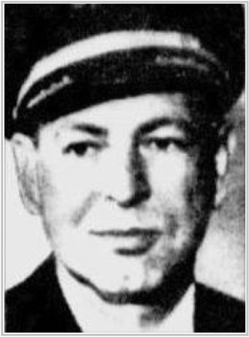
CAPTAIN DON PAULY

Slide 55
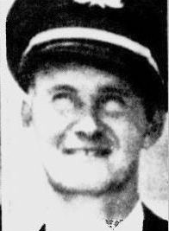
FIRST OFFICER JIM HILLIER

Slide 56
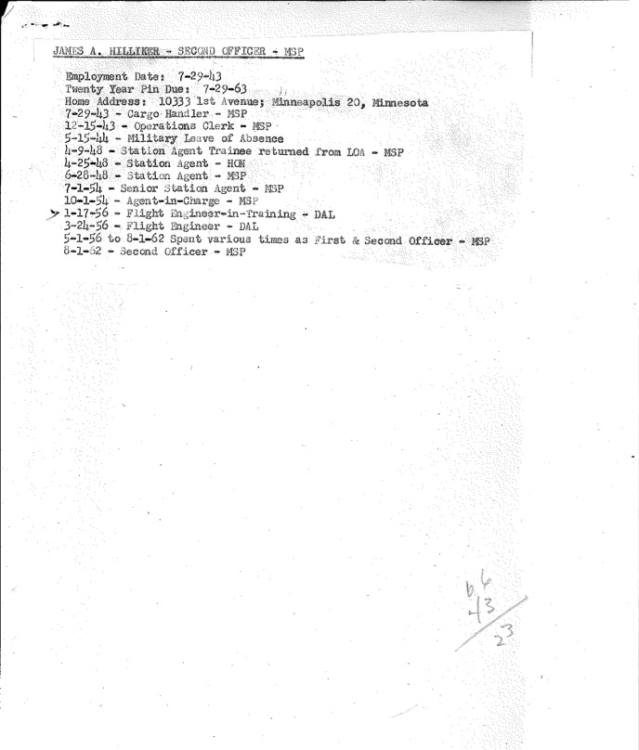
ADDITIONAL INFO
FOR JIM HILLIKER

Slide 57
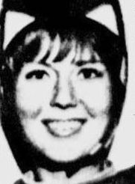
HOSTESS SHARON HENDRICKS

Slide 58
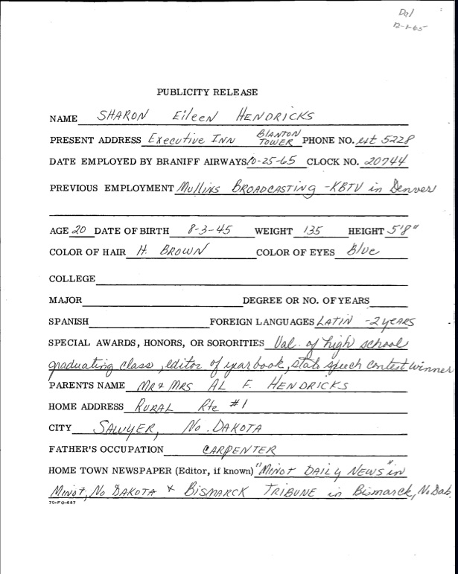
SHARON JOINS BRANIFF
PR DETAIL SHEET

Slide 59
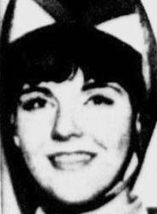
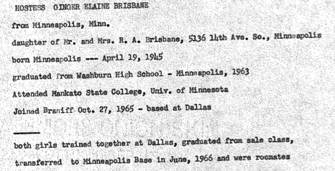
HOSTESS GINGER BRISBANE

Slide 60
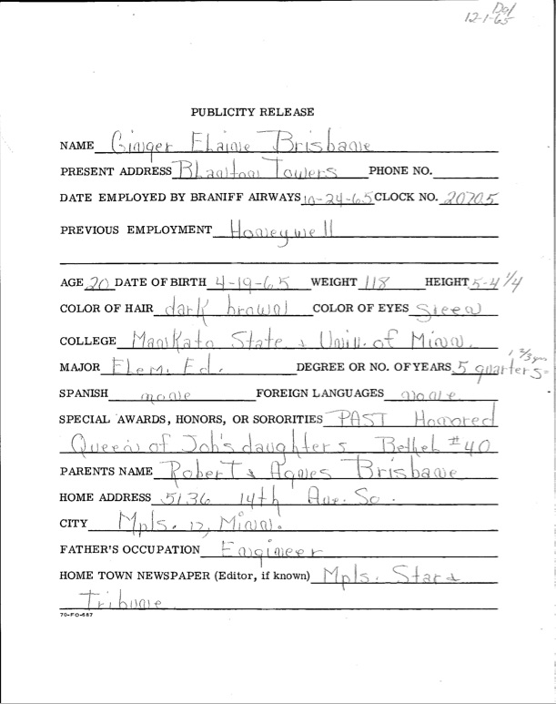
GINGER JOINS BRANIFF
PR DETAIL SHEET

Slide 61
OCT. 25, 1965 CLASS
NEW BRANIFF HOSTESSES

Slide 62
FUNERAL STATUS REPORT 1
LIST OF DETAILS

Slide 63
FUNERAL STATUS REPORT 2
LIST OF DETAILS

Slide 64
SAMPLE REPORTS
FUNERAL
COORDINATION

Slide 65
SAMPLE REPORTS
FUNERAL
COORDINATION

Slide 66
THANK YOU!

